Slide 1
STARS Forms
4.12.18

Slide 2
Agenda
Sharing Data
Outreach Forms
  Group
  Media
Beneficiary Contact
Part D/MAPD Enrollment Data
Data Transfer from NPR
Activity Form
Training Plan
Questions

Slide 3
Sharing Data
With MIPPA, SMP, and Duals Demo Grants

Slide 4
Sharing Data Overview
Each of the three main forms (Beneficiary Contact, Group Outreach, and Media) have the ability to share data with MIPPA and/or SMP
Ensure the appropriate boxes are checked and entered in order to accurately report shared program activities

Slide 5
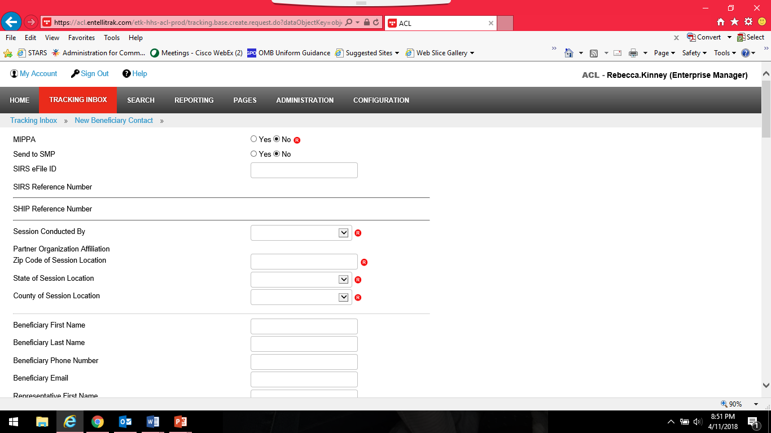
MIPPA
MIPPA Field is required
Simply check the radio button for “Yes” at the top of the page

Slide 6
SMP Reporting
To send a form to SMP SIRS you will need to select “Send to SMP” at the top of the form
The SIRS eFile ID will be auto-populate based on the user logged into STARS (as long as the SIRS eFile is also located on the users STARS Team Member profile)
  SIRS eFile ID can be updated to someone else’s number if needed but the ID must be present on the STARS form for the data to transfer to SIRS
Once saved the SIRS Reference Number will populate

Slide 7
SMP Reporting, cont.
Data is shared one way only (STARS to SIRS) and only once
  Cases updated in SIRS will not also be updated in STARS
  In the event of an error, users must log in and update forms in both systems to make corrections/edits
SMP Complex Issues must be finalized in SIRS
“Send to SMP SIRS” should only be used for cases and activities that fall under both SHIP and SMP
  Only forms that include SMP related topics will be sent to SIRS

Slide 8
CMS Duals Demo Grants
Those with the CMS Duals Demonstration Grants will be able to use STARS to report activities for these grants
Select Topics Discussed box “Duals Demonstration” in the appropriate field on the form
  Location of this item varies by form but is in the section describing the topics discussed or covered by the event
All additional details of the form may be analyzed by ACL and/or CMS in relation to the Dual Demonstration Grant

Slide 9
Outreach Forms
Splitting the PAM Form

Slide 10
Splitting the PAM Form
NPR Public And Media (PAM) form has been split into two new forms in STARS:
  Group Outreach
  Media
Details of what is being collected is similar
Two forms should simplify reporting and clarify which elements count towards performance measures

Slide 11
Group Outreach & Education
Collects Information on:
  Interactive presentations
  Health Fairs
  Enrollment Events
Data collected on this form will count towards SHIP Performance Measure #2 – Outreach
NEW Feature – Provides the ability to report multiday events and activities
  Ability to select a start and end date for events

Slide 12
Media Outreach & Education Form
Collects all data related to Media including billboards, email blasts, print articles (newspapers, magazines, newsletters, etc.), radio, and TV
Allows for wide range of Geographic Coverage selections:
  County or Counties
  Mulit-State
  Statewide
  Regional
  National
  Zip Code
Also includes both Start and End dates to allow reporting of multiday activities

Slide 13
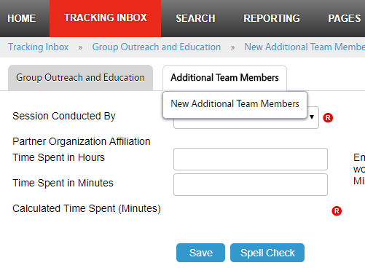
Adding Additional Team Members
Both Group Outreach and Media forms allow for the ability to enter multiple team members
Once the main form is saved you can add a secondary form to enter as many additional team members as needed
Note for proprietary systems: API does not currently support this feature. ACL is working with BAH on a possible enhancement to add this to API.

Slide 14
Beneficiary Contact Form

Slide 15
How Did Beneficiary Learn About SHIP?
Updated options include:
  Congressional Office
  Health/Drug Plan
  SHIP TA Center
  SSA
  State Medicaid Agency
Pulled “1-800-Medicare” out of the “CMS Outreach” option so now they appear as separate selections independent of each other.
Added “SHIP” as a qualifier in front of some of the selections to clarify that the selections are specific to SHIP activities/efforts. (i.e. “SHIP Mailings” and “SHIP Presentation”)

Slide 16
Method of Contact Changes
The options under Method of Contact have changed slightly to include Web-based contacts
  This option would be selected when using things such as website chat options to counsel a beneficiary

Slide 17
New Topics Discussed: Disenrollment
New option under Medicare Advantage and Medicare Part D
  To be used anytime a counselor assists with plan disenrollment at any time
  Allows tracking of enrollments and disenrollments separately

Slide 18
New Topics Discussed: Part D LIS
Two new options found under Part D Low Income Subsidy (LIS/Extra Help)
  Application Submission: Selected if you assist with submission of an LIS application, either paper or electronically via SSA’s website.
  LI NET/BAE: Selected if you help a beneficiary get LIS established by using the LI NET process or by contacting the CMS LI NET contractor. This includes submitting required documents for the Best Available Evidence (BAE) process to get the LIS benefits in place for the beneficiary at the pharmacy counter or point-of-sale.

Slide 19
New Topics Discussed: Medicaid
Expanded options under the Medicaid header to include:
  Application Submission
  Medicare Buy-In Coordination
  Medicaid Managed Care
  Recertification

Slide 20
New Topics Discussed: Other Insurance
Several additional options have been added under Other Insurance:
  Active Employer Health Benefits
  Indian Health Services
  Retiree Employer Health Benefits
  Tricare For Life Health Benefits
  Tricare Health Benefits
  VA/Veterans Health Benefits

Slide 21


New Topics Discussed: Additional Topics
A whole new category of topics has been added under the header Additional Topic Details which includes:
  Ambulance
  Dental/Vision/Hearing
  DMEPOS
  Duals Demonstration
  Home Health Care
  Hospice
  Hospital
  New Medicare Card
  Preventive Benefits
  Skilled Nursing Facility
Note to CMS Duals Demonstration Grantees:
Contact forms must include selection of “Duals Demonstration” on this area of the form (pictured below).

Slide 22
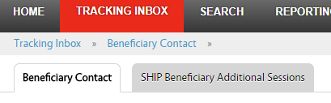
Additional Contacts on Same Issue
STARS allows users to group together multiple contacts involving the same issue
Click the SHIP Additional Sessions tab to add additional time and details
Would be used only on complex cases that require multiple contacts to complete
Note for proprietary systems: API does not currently support this feature. ACL is working with BAH on a possible enhancement to add this to API.

Slide 23
Part D/MAPD Enrollment Data

Slide 24
Overview
SHIP Evaluation results showed that SHIPs strongly desire a way to measure savings to Medicare beneficiaries
ACL Pilot:
  Over the last year ACL has conducted a pilot project with a number of SHIPs to test collection of enrollment data.
  Counselors in the pilot reported the before and after costs whenever they assisted with a Part D or MAPD enrollment.
  Data used comes directly from the Medicare Plan Finder
  Data from pilot was encouraging enough for ACL to decide to roll-out these data elements to everyone now
Goal is to provide more detailed information on the work that SHIPs do and the service we provide to beneficiaries

Slide 25
Components of New Data
New Data collection elements allow analysis of three components that will help measure the impact of SHIP programs’ ability to provide savings for beneficiaries:
  Number of beneficiaries who received PDP/MA-PD enrollment assistance;
  Average savings per beneficiary who received PDP/MA-PD enrollment assistance;
  Total savings for state.

Slide 26
Collection of Enrollment Data
Counselors will be asked to report this additional data whenever they assist with an enrollment in either Part D or MAPD plan
  Includes reporting cost data for both old plan and new plan (using Medicare Plan Finder info)
Everything reported on this element must be auditable for us to be able to justify the numbers reported
  Therefore ACL is asking for supporting documentation to be included whenever this data new is reported

Slide 27
Part D/MAPD Enrollment Data Steps
Collect plan estimated cost information from Medicare Plan Finder (MPF)
Assist beneficiary with enrollment via MPF or via phone or paper application
  Enrollment confirmation information must be saved no matter which method of enrollment used.
Enter plan cost amounts in STARS SUFs on the Beneficiary Contact Form (BCF)
Attach MPF cost and enrollment verification to the BCF
  Proprietary system users will need to keep these documents somewhere locally where they could be accessed if audited.

Slide 28
STARS Plan Cost SUF Fields
Original PDP/MA-PD Cost
  Enter the Estimated Drug Cost* of the plan the beneficiary’s current plan listed in the Medicare Drug and Health Plan Finder
  If beneficiary has no current Medicare PDP/MA-PD plan, then enter the drug costs displayed for Original Medicare
  Round to nearest whole dollar
New PDP/MA-PD Cost
  Enter the Estimated Drug Cost* of the future plan the SHIP team member assists the beneficiary current plan listed in the Medicare Drug and Health Plan Finder
  Round to nearest whole dollar
* Enrollment timing will dictate whether the ’Estimated Drug Cost’ appears as an ‘annual’ cost or ‘rest of year’ cost.

Slide 29
Ongoing Quality Checks
SHIPs should conduct regular quality checks to assure accurate reporting
  Once we get further into STARS enrollment ACL will provide technical assistance to SHIP directors and managers to help you determine how to best audit your own data
ACL Project Officers will conduct regular quality checks to ensure the data being report is sound and verifiable
Any cost change data without verification will need to be deleted if requests to provide supporting materials are not met

Slide 30
Data Transfer from NPR
How is this going to work?

Slide 31
Data Transfer and Timing
BAH will transfer the data from NPR beginning in October after everyone has transitioned to STARS
Once you transition to STARS your old data in NPR will be available as read-only until November 30th

Slide 32
Accessing NPR Data in STARS
NPR data will be moved to the state level in STARS
  Only State-level users will be able to see and search this data
Individual forms can be reassigned to STARS team members and sites by state level staff, BAH, or ACL if needed
Counselor field on NPR transferred data will be blank in STARS
  Counselor information will be saved in the 4th SUF in the transfer
  Agency name will be saved to the 5th SUF
  If you pull up one of the NPR transferred forms you can update the counselor field upon saving it in STARS if you choose to do so

Slide 33
Activity Form
Collecting other time

Slide 34
Collecting Other Time
The Activity Form allows users to enter blocks of time they have spent on SHIP that is not reported on any of the other forms
Time is collected by Month
  Can be entered more often if desired
Includes:
  Administrative Support
  SHIP Program Management/Team Member Management
  Other SHIP Activities
Time entered here will count towards the Resource Report
Note for proprietary systems: API does not currently support this feature. ACL is working with BAH on a possible enhancement to add this to API.

Slide 35
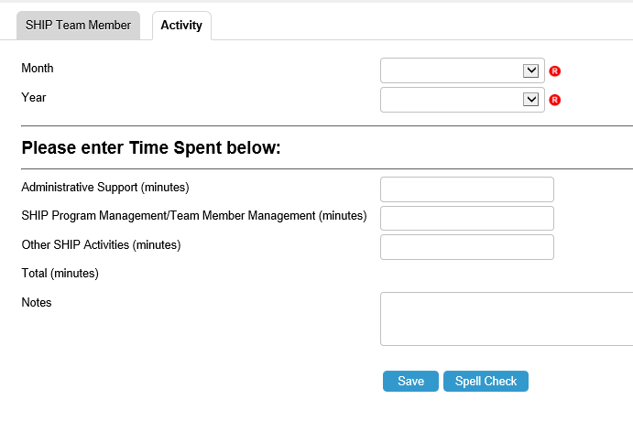
Activity Form Steps
Locate the Activity Form by first navigating to the Team Member page then click on the Activity tab
Enter Information
Save

Slide 36

Training Plan and Updates
Ginny Paulson, SHIP TA Center

Slide 37
Communication Plan
Webinars
  Advertised to SHIP director and administrator users of www.shiptacenter.org
  Center’s online calendar
  Constant Contact
  SHIP director listserv
  Archived on STARS resources page
    SHIP Library will list resources and link to STARS resources page
Written materials
  Housed on STARS landing page
  Listed in SHIP Resource library
    Directors/Administrators until roll-out is complete
Collaborative Effort
End Users Satisfied
Notes:
Instead of housing two sets of materials, we are housing everything on the STARS Resources page, then linking from the Resource Library. That way, users of both systems can access the materials, and we can avoid version control problems. Job aids are likely to be revised monthly, based up on SHIP questions and requests.

Slide 38

Job Aid Topics
STARS User Basics
  One for STARS Submitters
  One for everyone else
Beneficiary Contact Form
Group Outreach and Education Form
Media Outreach and Education Form
Entering Team Members
STARS Launch
Reports, Searches, and Management Tools
Notes:
Topics in green are ready now. Topics in orange are pending. All of the job aids were updated this week. Roles clarified, based upon questions that have come in.

Slide 39
Future Webinars
STARS Forms Overview (once only, 4/12/18)
Entering Team Members (monthly through July)
Beneficiary Contact Form (twice monthly)
For Directors and Administrators and their designees
For anyone with the capability
For all users (representatives from past groups and the group preparing for their start date;
not future groups)
Group and Media Outreach (monthly)
For all users (representatives from past groups and the group preparing for their start date;
not future groups)
Reports/Searches (monthly, starting in June)
For anyone with the capability
Notes:
Representatives from past groups and the group preparing for their start date

Slide 40
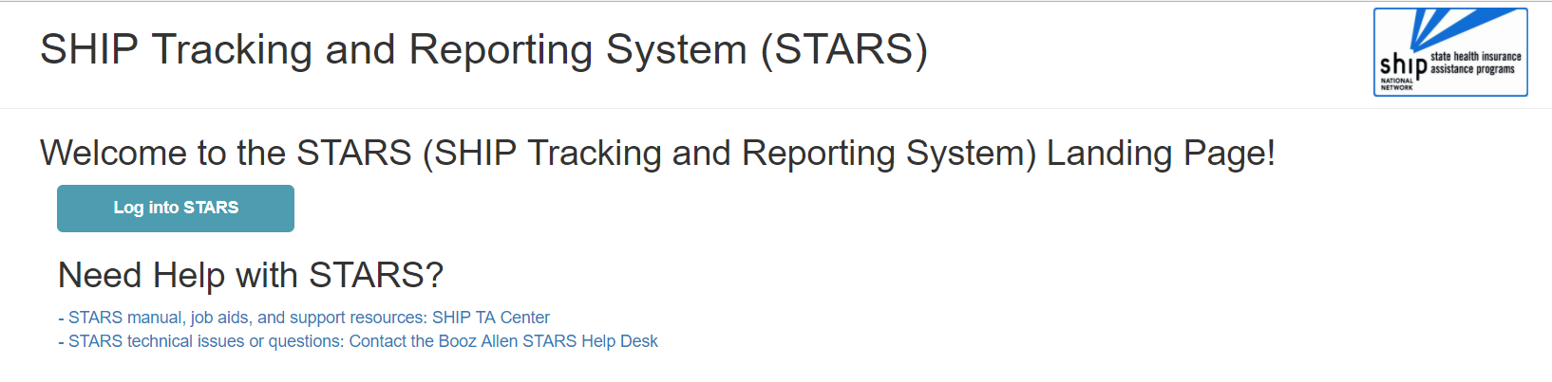
STARS Landing Page
https://stars.entellitrak.com
Contains link to SHIP TA Center STARS training materials (and, when it becomes available, ACL’s STARS manual)
Contains link to Booz Allen STARS Help Desk
Notes:
You can visit the STARS landing page now but you won’t be able to log in until you receive your credentials. You will be able to follow the link to the SHIP TA Center material, however.

Slide 41
Individualized Technical Assistance
SHIP Directors with enhancement requests or other programmatic questions should email ACL at ship@acl.hhs.gov.
For STARS username, password, and hierarchy support:
  Contact the STARS help desk at Booz Allen Hamilton, boozallenstarshelpdesk@bah.com or 703-377-4424
For STARS resources support:
  Contact the SHIP TA Center, stars@shiptacenter.org or
  877-839-2675.

Slide 42
Questions?
You can raise your hand in WebEx to ask your question over the phone line, or you can send your question by chat.
Today’s presentation and the three forms job aids are available now for download from within WebEx

