Slide 1
Accessing STARS Resources
Webinars
Manual
Handouts
Notes:
Sarah
Now I’m going to talk a little bit about the resources that are available on our password-protected website (www.shiptacenter.org). If you enter data directly into STARS, you should be able to see the STARS resources. If you can’t, talk to your supervisor or SHIP Director.

Slide 2
STARS Landing Page
https://stars.acl.gov
Contains link to SHIP TA Center’s STARS Resources page
Contains link to Booz Allen STARS Help Desk
Notes:
Here is the link to the STARS landing page. Anyone with the link can visit the STARS landing page. BUT, only users with credentials can successfully log in. ​

Slide 3
STARS Resources
Notes:
SHIP directors and SHIP administrators approve accounts to log into

Slide 4
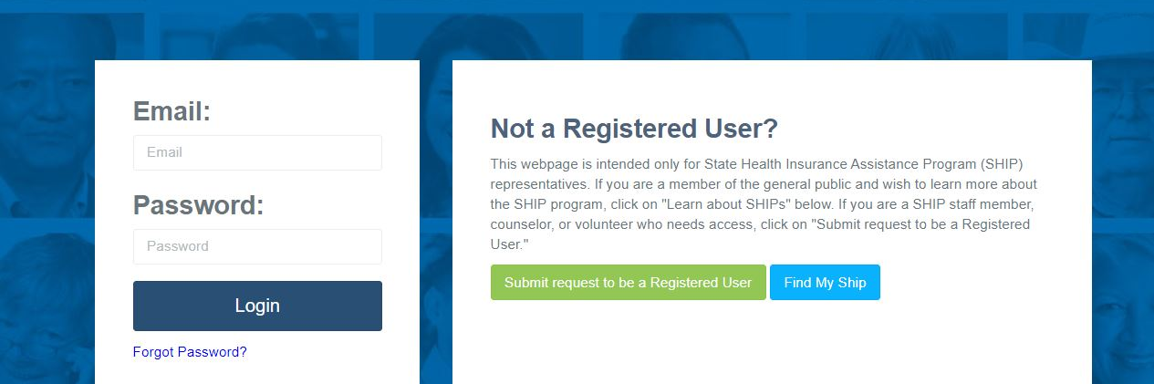
Login Interface
Anyone who needs access to STARS Resources should log in (or register for an account to log in).
Director and Administrator account holders approve requests
Directors and Administrators must check a “Can See STARS Resources” box when approving users who need access to the STARS Resources Kit
Notes:
If you don’t have an account, you can request one here (under the login page).​

Slide 5
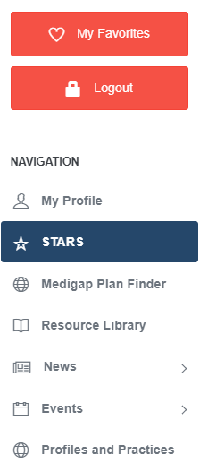
STARS Access and Resources
Notes:
The STARS Resources Kit is now on this STARS menu. Directors and administrators control STARS resources visibility, including access to STARS events.

Slide 6
STARS Manual and Other Resources
STARS Manual:
Chapter 1: Introduction
Chapter 2: User Basics
Chapter 3: Team Member Management
Chapter 4: Beneficiary Contacts
Chapter 5: Group and Media Outreach and Education
Chapter 6: STARS Searches
Chapter 7: Part D Enrollment Outcomes: Data Entry, Quality Assurance, and Reports
Forms, Handouts, Job Aids, and Webinars about:
CMS Unique ID
Director attestations
Performance measures at-a-glance references
STARS and SIRS tip sheet
User roles overview
Notes:
Chapter 1 covers: Programs that use STARS; Data entry due dates; How to get resources and technical assistance.
Chapter 2 covers: STARS address/landing page; Credentials (usernames and passwords); STARS security; STARS inactivity rules; Entering hours on your own team member form
Chapter 3 covers: Creating and Managing Team Members; Using the Activity Form; CMS SHIP Unique ID; Detailed user role descriptions and the impact of the STARS hierarchy
Chapter 4 covers: Beneficiary Contact Form and the Beneficiary Additional Sessions Form
Chapter 5 covers: Group outreach and education (GOE) and media outreach and education (MOE) forms
Chapter 6 covers: STARS Searches vs. STARS Reports, and how to conduct searches.
Use the job aids, handouts, and PPTs for searches, reports, and user role overview.

Slide 7
STARS Training Webinars
Archived in STARS Resources Kit
September 2020 – Entering PDP and MA-PD Cost Changes
November 2020 – Beneficiary Contact Forms
November 2020 – Group Outreach & Media Outreach Forms
November 2020 – MIPPA Beneficiary Contact Form
November 2020 – Team Member & Activity Forms
September 2021 – Quality Assurance Process for Part D Enrollment Outcomes
September 2021 – Using Your CMS Unique IDs
September 2021 – SHIP and MIPPA Performance Measures Reports
Notes:
This is the last webinar in our series. Here are a list of past webinars that you might find useful. All have recordings available in our Resource Library.

Slide 8
Individualized Technical Assistance
For STARS access difficulties or functionality concerns, contact the STARS help desk at Booz Allen Hamilton:
boozallenstarshelpdesk@bah.com or 703-377-4424
For programmatic assistance using and understanding STARS, contact the SHIP TA Center:
stars@shiptacenter.org or 877-839-2675
SHIP TA Center STARS staff:
Dennis Smithe: dsmithe@shiptacenter.org, 319-287-1183
Sarah Fleming: sfleming@shiptacenter.org, 319-874-6869
Ginny Paulson: gpaulson@shiptacenter.org, 319-287-1180
Notes:
Contact us or BAH for technical assistance. As a reminder, BAH will help with technical issues (passwords, etc), while we are able to help with programmatic questions.

Slide 9
Puzzled by STARS? Don’t hesitate to contact the SHIP TA Center for help.
This project was supported, in part, by grant number 90SATC0002 from the U.S. Administration for Community Living, Department of Health and Human Services, Washington, D.C. 20201. Grantees undertaking projects under government sponsorship are encouraged to express freely their findings and conclusions. Points of view or opinions do not, therefore, necessarily represent official Administration for Community Living policy.

