Slide 1



Virtual Event Production 101
For Web-Based outreach or Training
Notes:
This PowerPoint is based upon training developed and provided by the Senior Medicare Patrol (SMP) National Resource Center

Slide 2

Administration for Community Living, Office of Healthcare Information and Counseling
Managing Through COVID-19 Workgroup
September 2020

Slide 3
Steps to a Successful Event
Get ready to host
Schedule and announce
Follow up
Prepare
Host
and share resources

Slide 4
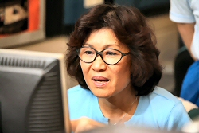
Step 1: Get ready to host events
A. Set up your technology and learn how to use it!
Web conferencing platform: questions to consider
  Related software/programs
  (e.g. surveys, email program)
  Physical setup… test everything!
  High-speed, grounded internet connection
  Computer and backup computer
  Landline phone
  Headset
  Video camera (or not)
Tip: See the Webinar Production Checklist for details.
Notes:
See the Webinar Production Checklist for additional talking points.

Slide 5
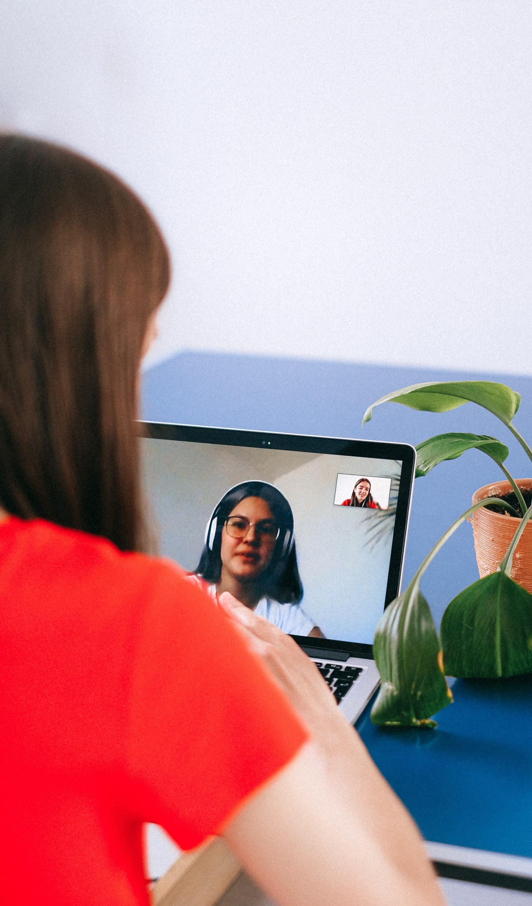

Step 1: Get ready to host events, cont’d
B. Set up your team
  Event host(s)
  Presenter(s)
  Event coordinator
  Backup/tech support for attendees
  Communications specialist
  PowerPoint developer/editor
  Quality review/second set of eyes
Notes:
Check-in question: Yes/No: Do you have someone else on your team who can be your second set of eyes?
If possible, each step of the process that involves content development or data entry (e.g. event setup in your web conferencing platform, communications to attendees, and the PowerPoint presentation) should be reviewed at least twice. Two sets of eyes are best, but if you’re the only one, do the work one day and perform your own review the next day, with fresh eyes. However, if you think you don’t have someone else to help you, keep in mind that you might have a volunteer on your team who would LOVE to do this type of work with you, and maybe all you have to do is ask.
Tech support for attendees: E.g. the Centers provide WebEx Tips, a direct number for WebEx, plus additional support from the Centers – ideally, someone other than the event host; we also have a backup host in case of emergency; another option is to have a second computer – e.g. laptop logged in as a participant.

Slide 6

Rule of webinars and technology
“
It’s not a question of whether or not something will go wrong, but what and when. Prepare for the worst and hope for the best!
”
Notes:
Technology’s great when it works! Unfortunately, technology doesn’t always work. Always be prepared with a backup plan, and be prepared to think on your feet if, or when, something goes wrong. What’s the best way to prepare? (next slide)

Slide 7

Step 1: Get ready to host events, cont’d
C. Practice!
  Practice using your technology.
    Create practice sessions using the same account and setup as the event.
    Make sure you are comfortable using any web conferencing tools that may be needed.
    Assign someone to practice joining “by phone only” to ensure attendees without internet connection can still participate by phone
Notes:
Practice! The more you practice and the more you expect something to happen, the more prepared you’ll be!

Slide 8

Event Production: Additional Resources
Webinar Production Checklist
Webinar Presenter Guide (Template)
Event Production 201 PowerPoint
Notes:
These resources are also part of the toolkit containing this PowerPoint

Slide 9
Step 2: Schedule and announce an event
Identify the need for a specific web-based event (i.e. “webinar”).
Determine the webinar basics.
Prepare to announce the webinar.
    Announce 30 days in advance whenever possible.
    Work with the presenter(s) to develop the event name, description, date, and time.
    Set up the event in your web conferencing platform.
    Send a calendar meeting request to presenters and panelists.
  Announce the Event.
Tip: See the Webinar Production Checklist and Webinar Presenter Guide (Template) for details.

Slide 10
Step 3: Prepare for the event
Follow up with presenters.
    Schedule a walkthrough meeting.
    Email the presenters to request the PPT and other materials prior to the walkthrough.
    Include interaction!
    Get the PPT.
Tip: See the Webinar Production Checklist and Webinar Presenter Guide (Template).
Notes:
Check-in question: Yes/No: Do you already include interaction in your webinars? How about your in-person training?
For example, in WebEx we can use yes/no questions, hands, chat, poll, and more.

Slide 11
Event Announcement Contents
Title, date, and time (include time zone).
Description
Intended audience
Event materials info – explain when and how they will be provided
Link
    Do they need to register? If so, include the registration link and registration instructions
    If they use the link in the announcement to join, make that clear
Connection instructions.
    Explain what to expect when accessing the link
    Include how to join “by phone only” if their technology is limited

Slide 12

Step 3: Prepare for the event, cont’d
  Hold a walkthrough meeting.
  Complete any final event setup.
  Send reminder emails to attendees and presenter(s).
Tip: See the Webinar Production Checklist and Webinar Presenter Guide (Template).
Notes:
Check-in question: Yes/No: Have you ever held a walkthrough meeting?
The walkthrough is one of my top suggestions, especially when working with presenters who are new to working with you. The walkthrough allows you to test technology, talk through the flow of the event, develop rapport with presenters, develop questions for interaction, etc. In my opinion, it’s the biggest trick to making the magic happen during the event.
See the Webinar Production Checklist for additional talking points.

Slide 13

Step 4: Host the event and share resources
Share resources before and/or after the event.
Host the Event.
    Start the event 30 minutes early.
    Share/upload the PPT and any other files, polls, etc.
    Greet attendees as they join and provide technical assistance.
    At call start time: mute all lines and start the recording.
    Start on schedule and stay on schedule!
    Follow the outline provided to presenters in the reminder email, managing interactions and Q&A.
Notes:
See the Webinar Production Checklist for additional talking points.
E.g. Centers post PPT/handout 1 day before and recording 1 day after.

Slide 14

Step 5: Follow up after the event
Hold an event “post-conference” meeting.
Perform follow-up as needed:
    Attendance lists
    Survey results
    Follow-up on unanswered questions
    Grant reporting about the event
    Post recording and additional resources
    Delete announcement templates posted on website
Notes:
Check-in question: Yes/No: Have you ever held an event post-conference meeting?
It allows you to do a quick check-in about any lingering questions, thank your presenters, and discuss any next steps needed.
See the Webinar Production Checklist for additional talking points.

Slide 15
Which of these is your least favorite?
Canceling an event after it’s announced.
Announcing an event for the wrong date or time.
Adding or changing presenters after an event is announced.
Sending an event invitation to the wrong audience.
Presenters who read directly from their PPT slides.
Notes:
ACTIVITY (use your pointer, conduct a poll, use chat, or use another interaction option in your platform)
My least favorite is canceling an event! One of the most frequent complaints the Center sees in our post-webinar surveys is about presenters who read directly from their slides. Not me, of course, and I hope not you, either!

Slide 16
Which of these is your favorite strategy for a successful event?
  Announce each event 30 days in advance.
  Have a walkthrough meeting.
  Have a second set of eyes.
  Include interaction in your presentation.
  Invite volunteers to participate in the webinar production process.
Notes:
ACTIVITY (use your pointer, conduct a poll, use chat, or use another interaction option in your platform)
You’ll have a chance to share other strategies in just a few minutes when we get to the Q&A and sharing session.

Slide 17
Event production timeline
2 – 3 months before
(or more)
Set up event technology
1 – 2 months before
(or more)
Identify event(s)
to produce
1 month before
(or more)
Determine details and set up the event
Set up your event production team
Practice!
Determine event basics
Announce the event!
Include instructions for joining “by phone only” (for those with limited technology)

Slide 18
Event production timeline, cont’d
2 – 4 weeks before
Work with presenters and production team to develop the presentation materials
1 week before
Finalize presentation materials
Hold the walkthrough meeting with presenters and production team
Send reminder (with instructions) to attendees
Schedule the walkthrough

Slide 19
Event production timeline, cont’d
Send reminders to presenters and attendees
Share resources with attendees
After the event
Day of the event
1 day before
Follow up as needed
Host the event (& record,
if applicable)
Share additional resources
Final event setup

