Slide 1



Safety Considerations Decision Tree
Event Planning During COVid-19

Slide 2
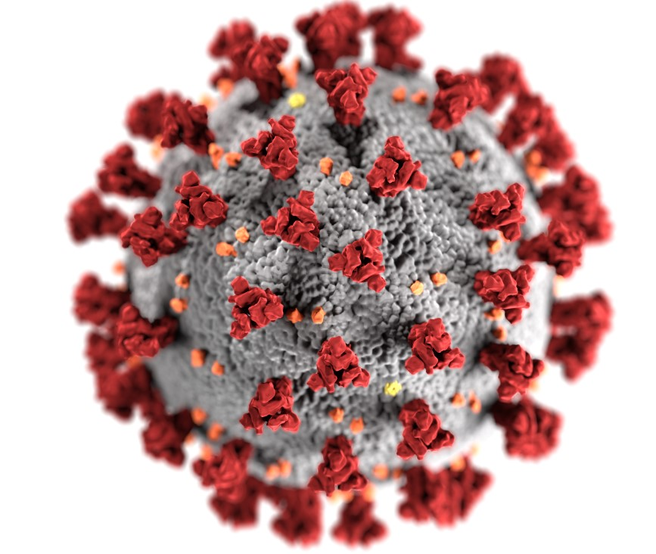
Administration for Community Living, Office of Healthcare Information and Counseling
Managing Through COVID-19 Workgroup
September 2020
This tool is designed to help plan events safely during the COVID-19 pandemic. This tool will ask questions to help you decide the appropriate venues for outreach and training events.

Slide 3
Event Planner’s Decision Tree
Highest Risk
Do you know your local, state and federal guidelines for in person events during COVID-19?
If in-person events are permitted, do you have a venue willing and able to accommodate identified safety guidelines/mandates?
In-person?
If in-person events are permitted, do you have a speaker and support staff willing to participate?
“Should my event be…”
Do you have the resources to safely handle an in-person event (people, finances, supplies, etc.)
Lowest Risk
Do you have the technology, expertise, and resources to host a virtual event?
Virtual?
Do you have a speaker willing to participate in a virtual event?
For additional information please see subsequent checklists and FAQs
Is your target audience willing and able to participate in a virtual event?

Slide 4
If you have decided to have an in-person event:
Early Planning Considerations
  Secure written approval from your agency and/or program leader to conduct an in-person event.
  Select a venue with space needed to comply with safety guidelines for social distancing and get their agreement to comply in writing.
  Review masking, cleaning, and other safety precautions
  Secure safety items and cleaning services for prior/during/following the event​.
  Plan your speakers, event flow, staff, and volunteers​.
  Develop your plan for handling noncompliant participants.
    See the tip sheet for how to talk to non-compliant attendees​
  Train presenters, staff, and volunteers on safety protocols and etiquette​

Slide 5
If you have decided to have an in-person event:
“At the Event” Considerations
  You will need advertising and on-site signage notifying participants of expectations.​
  You will need to set up secure, socially-distanced registration.
  Registration should include contact information should it become necessary to follow-up later.​
  At the event, remind participants of event expectations​ verbally and in writing.

Slide 6
If you have decided to have a virtual event:
Checklist
  See the Virtual Event Planning PowerPoints (101 and 201) for detailed step-by-step procedures and assistance with selecting a virtual platform.
  Here is a short checklist to get you started:
    Select a virtual platform.
    Plan speakers, event flow, staffing, and facilitators​
    Plan for and secure IT support to address technical difficulties
    Train event staff to use your platform
    Train event staff on virtual event etiquette​
    Set up secure registration
    Anticipate the needs of participants with limited access to technology or limited technology skills, and develop a plan to accommodate them

Slide 7
Federal, State, and Local Guidelines
For Virtual vs. In-Person Event Decision-Making

Slide 8
Federal Resources
See our short Federal Guidelines PowerPoint about Centers for Disease Control (CDC) and White House guidelines for serving vulnerable persons.
Federal Government Response: https://www.usa.gov/coronavirus​
CDC: https://www.cdc.gov/coronavirus/2019-ncov/index.html​
U.S. Administration for Community Living: https://acl.gov/COVID-19
healthdata.gov: https://healthdata.gov/
U.S. Department of Labor: https://www.dol.gov/agencies/whd/pandemic​
The President’s Coronavirus Guidelines for America:
  https://www.whitehouse.gov/wp-content/uploads/2020/03/03.16.20_coronavirus-guidance_8.5x11_315PM.pdf
Occupational Safety and Health Administration: https://www.osha.gov/SLTC/covid-19/​

Slide 9
State and Local Resources
State​ Sources
State specific Department of Health website​
State departments affiliated with facilitating agency​
Johns Hopkins University: https://coronavirus.jhu.edu/us-map ​
Local​ Sources
County specific Health Department website​
Agency specific website and policies/procedures/guidelines​
Program specific policies/procedures/guidelines​

Slide 10
CDC Signage, Checklists, Assessments
The CDC provides ready-made downloadable, printable posters, checklists, assessments and other resources for the events
​https://www.cdc.gov/coronavirus/2019-ncov/community/large-events/considerations-for-events-gatherings.html
https://www.cdc.gov/coronavirus/2019-ncov/downloads/community/COVID19-events-gatherings-readiness-and-planning-tool.pdf
https://www.cdc.gov/coronavirus/2019-ncov/communication/print-resources.html?Sort=Date%3A%3Adesc​
https://www.cdc.gov/coronavirus/2019-ncov/community/large-events/index.html​

Slide 11
FAQs
For Virtual vs. In-Person Event Decision-Making

Slide 12
Do You…
Do you have a speaker that will do an in-person event?​
Look locally within your agency, agency partners including SHIP/MIPPA/SMP, community experts, etc.​
Seek reputable materials and facilitate event with premade presentations.​
Do you have the resources to handle the event (people, financial, supplies, etc.)? ​
Consider budget or donations for event venue and supplies needed.​
Consider staff/volunteers available to assist at the event and their comfort/willingness with event guidelines.​
Secure safety items and cleaning services for prior/during/following the event (PPE, mask, gloves, sanitizer, cleaning wipes).​

Slide 13
Do You..
Do you have a system for registration? ​
Consider in person event guidelines for specifics of social distancing guidelines/etc. ​
Registration should include contact information, email, phone, etc.
Consider staff/volunteers needed to assist with safe/secure registration
Do you have a venue willing to accommodate identified guidelines?​
  Reference in person event guidelines for specifics of social distancing guidelines and clearly define. ​
  Consider space, masking, cleaning, and other precautions. ​

Slide 14
Do You..
Do you have posted on entry list of things that people should be aware of and know before entering?​
  Display identified guidelines including social distancing, masking, cleaning, etc. ​
  Consider using language about agreement not to attend if sick/recent exposure/temperature/symptoms/etc.​
Do you have a plan in place for handling noncompliant participants?​
  Reference in person event guidelines for specifics of social distancing guidelines and clearly define.​
  Consider consequences for participants who aren’t compliant with identified guidelines.​
  Consider how to notify participants of noncompliance. ​

Slide 15
Do you..
Do you have a plan in place if someone tests positive for COVID-19 following attendance of event?​
  Reference in person event guidelines and know the agency/local position.​
  Consider notification of your agency representative, local representative such as the local Health Department for next steps. ​
Do you know what liabilities to consider with holding an in-person event?​
Reference in person event guidelines. ​
Consider any legalities from your agency, event space, etc. ​
Reference plans for noncompliant participants. ​
Reference plan for someone testing positive following attendance of event. ​

