Slide 1
Introduction to STARS Searches
November 15, 2018
Notes:
Welcome to today’s webinar! Your presenters are Dennis Smithe from the SHIP TA Center, and me – Ginny Paulson from the SHIP TA Center.

Slide 2
Agenda
Overview:
  Searches vs. Tracking Inbox vs. Reports
  Standard Searches vs. Advanced Searches
Roles and Searches
FAQs
Demonstration of Searches
Resources
Q&A

Slide 3
Overview

Slide 4
The Three Big STARS Search Questions
What can I see?
Can I edit what I see?
How can I get out what has been put in?
Notes:
The answers to these questions depend upon User Roles, the tracking inbox functionality, and the STARS Searches functionality. The STARS User Basics job aids and the Roles overview answer the first two questions. Today’s webinar is about the final question.

Slide 5
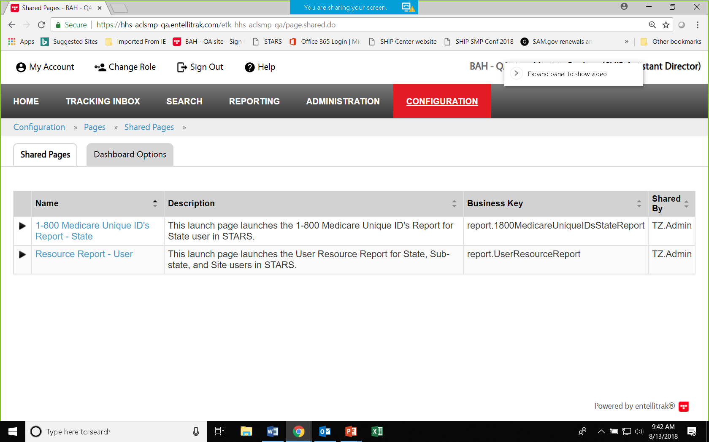
STARS Searching and Reports Tools:
What are the Differences?
Tracking Inbox: Search data entered by you and about you using column headings to sort in ascending or descending order.
Search Menu: Data entered by anyone, as long as it is visible to your role, using search tools to filter.
Reports: When released in early 2019, reports will quantify aggregated data.
  They will appear under a Configuration menu.
  The Reporting menu will not be applicable.

Slide 6
Standard vs. Advanced Searches
When to use a Standard Search: Standard searches allow you to find, view, and edit all data in STARS available to your role. For example, this is the fastest way to find forms entered by other team members.
When to use an Advanced Search: Use advanced searches when the results you seek aren’t available in a standard search, when you wish to export to Excel to manipulate the data, or when you want to access a shared search.

Slide 7
Side-by-Side Comparison
Search Type | Advantages | Disadvantages
Standard | Easy to define search criteria Can save for the duration of your session (“remember criteria”) Can sort search results by clicking column headings (like the tracking inboxes) | Cannot export to Excel Cannot save criteria for future sessions No shared search capability Cannot define the display format of search results
Advanced | Can export to Excel Can create more complex search criteria Can define search results display format (e.g. column preferences) Can be shared with and by other national users of the same role Can display saved searches on dashboard | More complex to understand and use A large number of criteria or columns may lead to increased strain on system performance, potential slowdowns, and potential errors
Notes:
This chart is in the job aid.

Slide 8
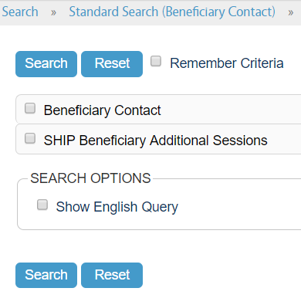
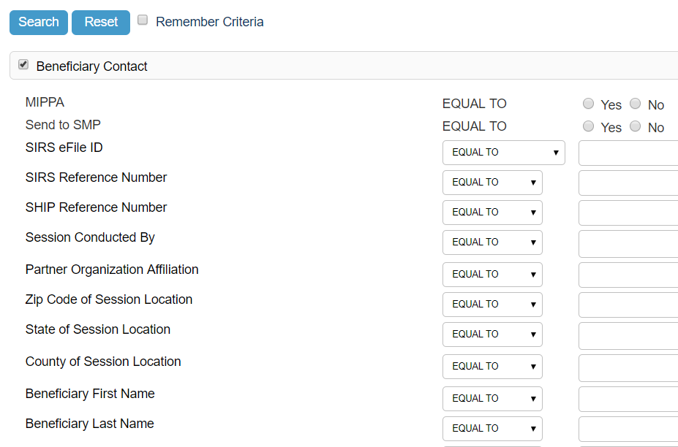
Standard Search: At-a-Glance
Step 1: Select the form (BCF, in this example)
Step 2: Select your criteria

Slide 9
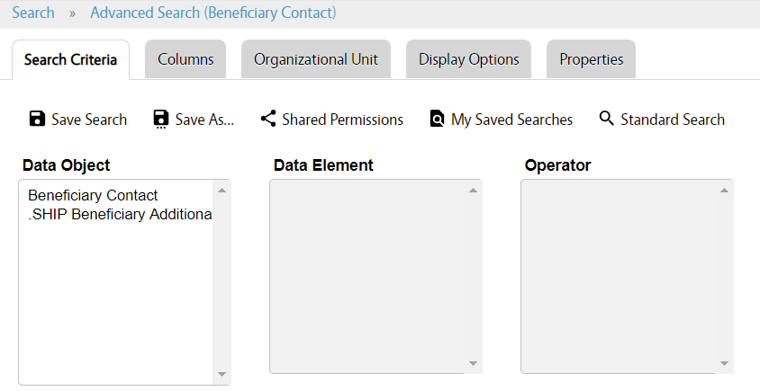
Advanced Search: At-a-Glance
Notes:
Search Criteria: Select the fields you will search and the criteria. Columns: Select additional data fields to display in search results. Organizational Unit: Narrow your search by sub-states or sites. Display Options: Choose your format.
Html to view within STARS
XLS (Excel) to export and manipulate
Doc (Word) is also an option
Properties: Name your saved search.

Slide 10
Advanced Search Tabs Explained
These five tab options appear for any advanced search. At a minimum, you must respond to the Search Criteria tab.
Search Criteria: Select the fields you will search and the criteria.
Columns: Select additional data fields to display in search results.
Organizational Unit: Narrow your search by sub-states or sites.
Display Options: Choose your format.
  Html to view within STARS
  XLS (Excel) to export and manipulate
  Doc (Word) is also an option
Properties: Name your saved search.
Notes:
Note: For optimal system performance, please limit included columns to those that are absolutely necessary. A large number of columns may lead to increased strain on system performance, potential slowdowns, and potential errors.

Slide 11
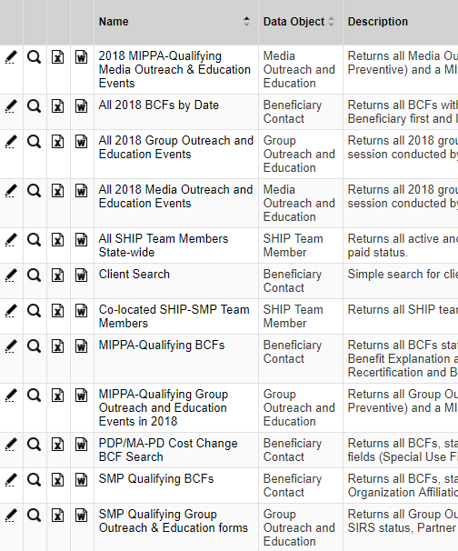
NEW! Shared Searches
Edit, View, or Export
Clicking Search Name Opens Search
Notes:
Here are currently available shared searches from ACL and the SHIP TA Center. Searches for team members are only available to the user roles that can view team members, however. Shared searches will be added and refined over time. (Note that only a portion of the Description appears in this screen shot.)

Slide 12
Roles and Searches
Notes:
Ginny

Slide 13
STARS Hierarchy
Notes:
This chart depicts the STARS hierarchy. Each entity in the hierarchy represents an organization. National Level organizations include Booz Allen Hamilton, ACL, and the SHIP TA Center. State level organizations are SHIPs. SHIPs may use a three-level hierarchy, like State 1 in the example below, a two-level hierarchy, like State 2 in the example below, or no hierarchy (i.e. State-level only). The number of Sub-States (i.e. regions) and/or Sites is determined at the State level. Users can search records associated with their organization and, if applicable, those that sit below them in the hierarchy. Each SHIP’s hierarchy was established in advance of the STARS launch and can only be edited by Booz Allen Hamilton.

Slide 14
Role-Based Search Capabilities
Role name | Capabilities
SHIP Director | Can search all data at the state level and below
SHIP Assistant Director | Can search all data at the state level and below
State Staff | Can search all data at the state level and below
Sub-State Manager | Search all data at the Sub-State level and below
Sub-State Staff | Search all data at the Sub-State level and below
Site Manager | Search all data at the Site level and below
Site Staff | Search all data at the Site level and below
Team Member | Search any forms at and below their level in the *hierarchy * Note: this role can be aligned with any level of the hierarchy; the decision is made when the Team Member is created Unable to search team members
STARS Submitter | N/A. No Search menu; must use the Tracking Inbox
Notes:
This chart is in the job aid

Slide 15
FAQs
Notes:
Ginny

Slide 16
When will the STARS Reports be available?
The 1-800-Medicare Unique ID Report is available now
  SHIP Director and SHIP Assistant Director role only
Reports that will be available in early 2019
  SHIP Performance Measure Report
  Resource Report
User roles with Reports access:
  Manager roles
  Director roles
  State staff

Slide 17
What is a “Child Object” in STARS?
A technical term used for STARS forms that are dependent upon other forms (i.e. – they are attached to another form). They are:
  SHIP Beneficiary Additional Sessions = child object to Beneficiary Contact Form
  Additional Team Members = child object to Group Outreach and Education Form and Media Outreach and Education Form
  Activity = child object to Team Member Form
Notes:
Talking point – this affects searches because you need to know where to find the data on these “dependent” forms. It’s not necessarily important to remember or use the term “child object,” as long as you remember that these three forms are attached to other forms

Slide 18
Saved Searches vs. Shared Searches
Saved searches are created by you and for you
Shared searches are shared with others nationally who also have your same role.
  You cannot share searches with others in your state who have a different role.
  You can modify searches that have been shared with you, change any criteria, and save the search with a new name.
    This saves the revised search just for you

Slide 19
Demonstration
Notes:
Outline:
Ginny - Standard: Find a beneficiary contact or contacts about a specific beneficiary and find team members to eliminate duplicates.
Dennis - Advanced: All Beneficiary Contacts for a partner within a date range that are MIPPA-qualifying (explain logic operator).
Dennis – Saved and Shared Searches

Slide 20
STARS Resources, Training, and Support
Webinars
Manual
Job Aids
Notes:
Ginny

Slide 21
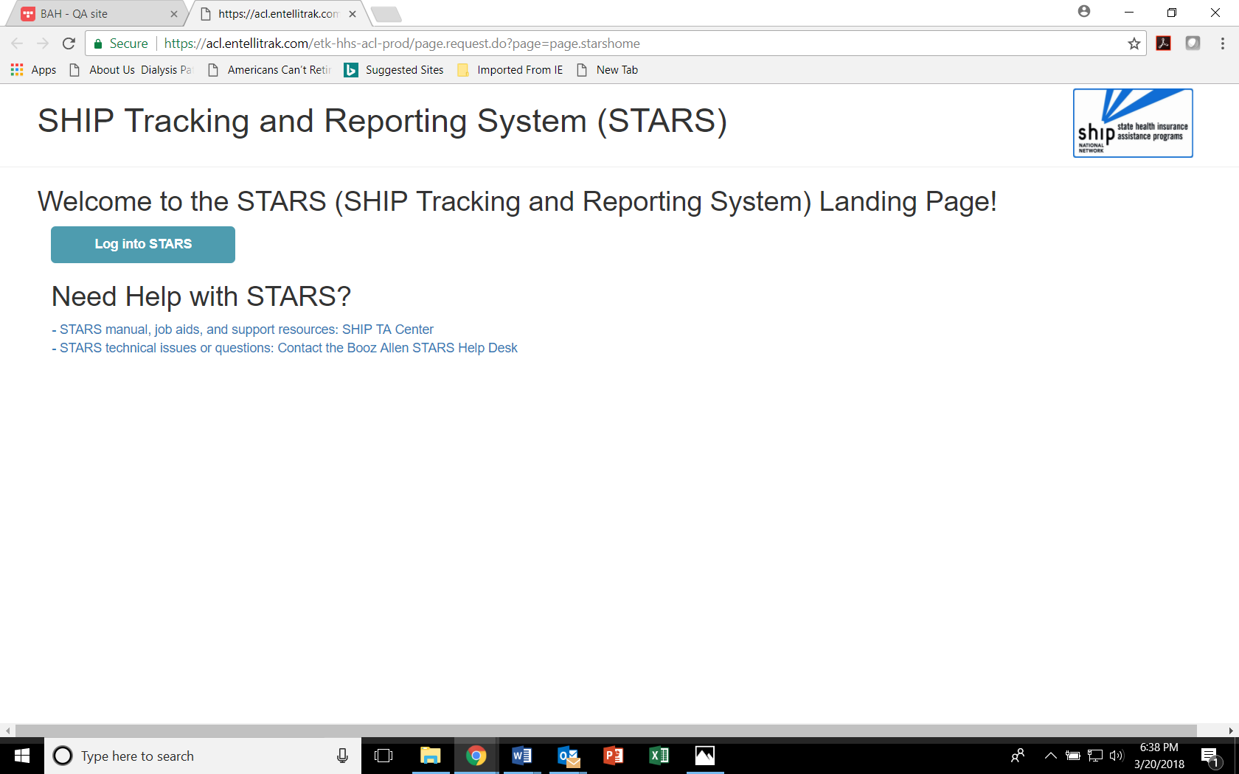
STARS Landing Page
https://stars.acl.gov
Contains link to SHIP TA Center STARS training materials, including webinar PowerPoints, recordings, and job aids (coming later in 2018 - ACL’s STARS manual)
Contains link to Booz Allen STARS Help Desk
Notes:
Anyone with the link can visit the STARS landing page now. BUT, only users with credentials can successfully log in. Anyone who visits this page WILL be able to follow the link to the STARS resources, however. It is up to leaders in each SHIP program to distribute the STARS landing page link as appropriate. Note that the STARS landing page URL may change in the coming months. Stay tuned for announcements.

Slide 22

STARS Job Aids
STARS User Basics
  One for STARS Submitter role
  One for all other roles
Beneficiary Contact Form
Group Outreach and Education Form
Media Outreach and Education Form
Team Members
STARS Launch
FAQs
Searches
Reports (2019)
Notes:
Topics in green are available now. They have been updated since their original release dates. The Reports job aid will be provided after the reports have been released into STARS.

Slide 23

Other Written Resources
PowerPoints for every STARS topic
User Roles at-a-glance (one page overview)
Beneficiary Contacts definitions
Group Outreach and Education definitions
Media Outreach and Education definitions
Printable versions of the STARS forms
STARS Security handout (i.e. slick sheet)
STARS Manual
Notes:
Topics in green are available now. By the way, we post the PowerPoint files from webinars – not PDFs – so that you can edit and use locally if desired. The STARS Manual will be available later this year. It will expand upon the job aids with increased definitions and guidance. Essentially, it will collect all STARS instructions and guidance in one document.

Slide 24
STARS Webinar Series
Group and Media Outreach Forms
(November 29, 2018)
About this series
Intended for all users invited by a SHIP leader
STARS Searches and Reports (November 15, 2018)
Beneficiary Contact Form
(November 27, 2018)
Notes:
This STARS launch webinar series began in March 2018.

Slide 25
Webinars and Other STARS Resources
Future Webinar Announcements
  Provided to the SHIP director listserv and to director/administrator users at www.shiptacenter.org
Webinar PPTs, webinar recordings, job aids, forms, and other resources
  Posted under “Need Help” on the STARS landing page
Collaborative Effort
End Users Satisfied
Notes:
We originally planned to resume our usual webinar announcement process after the STARS roll-out. Our usual process is to announce directly to registered users of our website based upon their role. We’ve decided that we need to retain our STARS webinar announcement process past October because of the 30+ SHIPs who use proprietary data systems. Their team members may not interact with STARS at all. Our webinar announcements would be likely to cause confusion in those 30+ programs. We will upgrade the password-protected area of our website to allow greater granularity in role permissions. The upgrade will allow you to tell us whether or not your users should received STARS training announcements. We expect the upgrade to be completed by mid 2019.

Slide 26
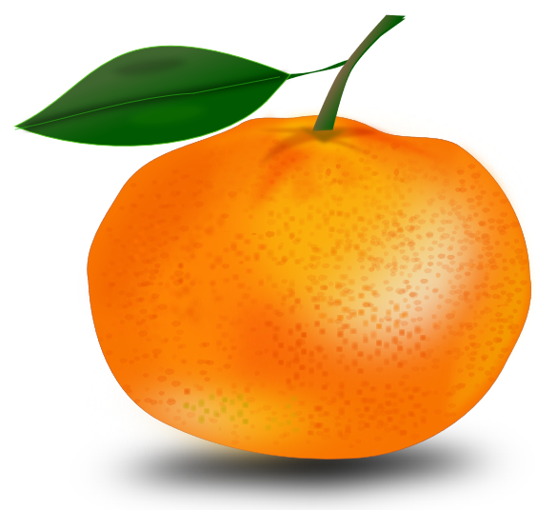
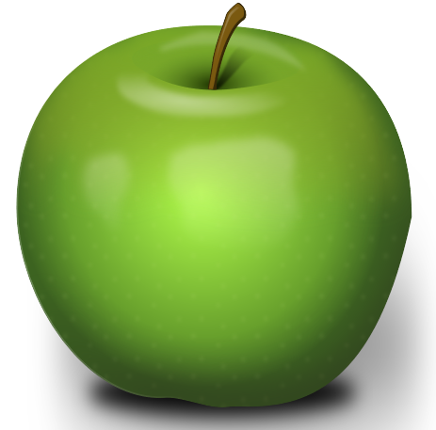
What’s the difference?
* www.shiptacenter.org
* https://stars.acl.gov
Operated by the SHIP TA Center
Houses resources to help SHIPs train and manage their programs and educate the public
Supported by the SHIP TA Center
Operated by ACL and Booz Allen Hamilton
SHIP data reporting system
Contains links to all STARS training materials for all Users
Supported by ACL, Booz Allen Hamilton, and the SHIP TA Center
* Both require logging in, but they are separate systems and require separate accounts (think apples and oranges)
Notes:
Ginny: Here is a slide we have started using in our webinars to help people understand our Center’s website vs. the STARS website and our role with each.

Slide 27
Individualized Technical Assistance
For STARS technical assistance, contact the STARS help desk at Booz Allen Hamilton:
  boozallenstarshelpdesk@bah.com or 703-377-4424
For questions about job aids and other STARS support resources, contact the SHIP TA Center,
  stars@shiptacenter.org or 877-839-2675
Today’s Speakers:
  Dennis Smithe: dsmithe@shiptacenter.org
  Ginny Paulson: gpaulson@shiptacenter.org

Slide 28

Have Questions?
Today’s webinar materials are available for download within WebEx.
They are also posted at https://stars.stars.gov
Move your mouse around the bottom of your screen to activate chat. Click the blue chat bubble at the bottom of your screen.
Notes:
Due to the size of today’s audience, we are taking questions through chat.

Slide 29

Thank you for participating!
Today’s webinar materials are available for download within WebEx.
They are also posted at https://stars.acl.gov
The production of this webinar was supported by grant number 90SATC0001 from the Administration for Community Living (ACL).

