Slide 1
SIRS and STARS Updates Webinar
October 3, 2018
Notes:
Ginny
Welcome!

Slide 2
WebEx functionality
2
The view icon in the upper right corner changes your view in WebEx.
Tip: Select the middle option so you can see who’s speaking!
The toolbar on the left side of the screen allows you to zoom in and out to show a closer or farther out view of the PowerPoint presentation.
The menu at the bottom allows you to mute your line, open the participants and chat panels, and leave the event.
The panels on the right show participant information, chat, and polling (when in use). Use the arrow and x to open and close the panels.
Tip: To raise your hand, open the participant panel and click the hand icon in the lower right corner.
1
4
3
Notes:
Ginny
I’d like to provide a quick tour of WebEx since this version is still fairly new.

Slide 3
Agenda
System updates
SIRS
STARS
“Send to SMP”
ACL guidance for SMP/SHIP/MIPPA
STARS to SIRS scenarios
Resources
Q&A
Notes:
Ginny
In this webinar, ACL will describe updates to SIRS and STARS that took place in September 2018, including updates to the “send to SMP” functionality. ACL will also provide an overview of updated guidance on how to report data when SMP, SHIP, and/or MIPPA programs are working together. The SMP and SHIP centers will provide sample scenarios to illustrate this updated functionality and guidance and highlight related resources.

Slide 4
SIRS and STARS Updates
New .gov URLs for SIRS & STARS Landing Pages
https://SIRS.ACL.gov
https://STARS.ACL.gov
Previous issues with the Standard Search functionality have been resolved.
The auto-generated passwords were re-formatted to make them simpler, but still secure.
Notes:
Stacey

Slide 5
SIRS Updates
The OIG Report has been updated so it now includes state-specific reports for every SMP grantee, including the 8 new SMP grantees and the former grantees for those states.
For security purposes:
The “assignments” functionality is no longer available.
eFile will no longer be available effective January 1, 2019.
Notes:
Stacey

Slide 6
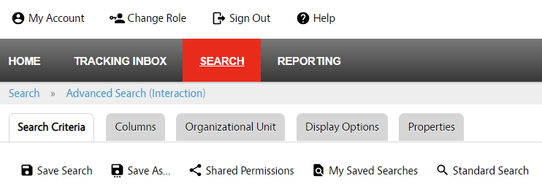
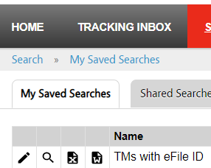
SIRS Updates: New Look
The “Administration” tab is no longer in view.
The graphics on some pages have a slightly new look, e.g. top menu, Advanced Searches, and My Saved Searches.
Notes:
Stacey

Slide 7
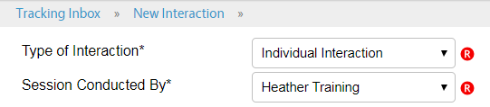
SIRS Updates: Interactions
All Interactions
The ‘Session Conducted By’ drop down was restructured so it only includes active team members (and excludes retired team members).
Tip: When retiring a team member, enter all of their data first!
Individual Interactions: The red caution message that appears once an Individual Interaction has been successfully saved has been removed.
Notes:
Stacey

Slide 8
SIRS Updates: Complex Interactions
The ability to delete files was added.
The types of acceptable files that can be uploaded were expanded to include M4A (voicemail) files.
A new option was added to the ‘Status of Interaction’ field, called ‘Closed – Handled by SHIP.’ Any interactions sent from STARS to SIRS using the ‘Send to SMP’ functionality will default to this status.
Notes:
Stacey
(Update on status of cases previously transferred from STARS.)

Slide 9
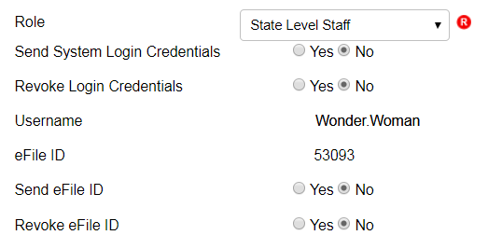
SIRS Updates: Team Members
A field was added to display the team member’s username.
An option for ‘Native American’ was added to the Race / Ethnicity drop down.
The ability to delete files was added.
The ability to delete Team Members has now been restricted to users at the SMP Resource Center, ACL, and BAH levels only.
Notes:
Stacey

Slide 10
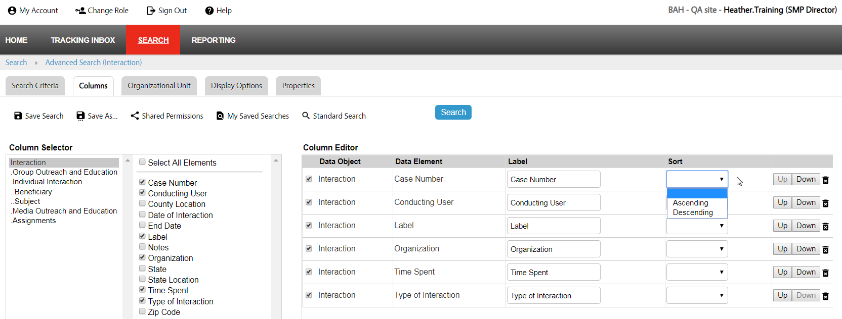
SIRS Updates: Advanced Searches
The look of some of the icons has changed.
The functionality to edit the column layout has changed, and has been moved from the top to the right.
Notes:
Stacey
The “Columns” tab is used to select which data fields will be included in your search. Each data field selected will appear as a separate column in the search results.
Tip: After selecting the desired columns, use the “Column Editor” section on the right side of the screen to change how the columns will appear when you run the search. Click the “Up” or “Down” buttons to change the order in which the column headings will appear in your search results. Use the “Label” field to change the name of any column heading. Use the “Sort” field to choose the default order for sorting data within the column by selecting the desired option from the drop-down menu.

Slide 11
STARS Updates
Removed “Other” as an option in the race categories
Working on finalizing the reports
The data is set to be transferred from NPR to STARS by January 1, 2019
Notes:
Rebecca

Slide 12
“Send to SMP” Updates: Overview
SMP-related data entered in STARS can be sent from STARS to SIRS using the “Send to SMP” feature
Only for SHIPs and SMPs who co-train team members and partner on data entry
Data entered into SIRS cannot be transferred to STARS – it’s a one-way transaction
See the STARS to SIRS Tip Sheet for details.
Notes:
Stacey
This allows SHIPs to send data that applies to both SHIP and SMP work from STARS into SIRS.

Slide 13
Send to SMP Functionality
For data to be sent from STARS to SIRS, you must follow these steps in STARS:
Answer “Yes” for the “Send to SMP” field
Enter the SIRS eFile ID for the team member conducting the session
For beneficiary contact forms, an SMP-related topic must also be selected
For outreach forms, the “Type of Event” must be a presentation or a booth/exhibit
Notes:
Stacey

Slide 14
Send to SMP Updates (Only impacts co-trained SMP/SHIP programs using the “Send to SMP” functionality in STARS)
Beneficiary Contact Form
If one or more SMP related topics are selected, the record will be sent to SMP and saved in STARS. If none are selected, the record will not be sent to SMP and not saved in STARS, even when “Send to SMP” is set to “Yes.”
If no SMP related topics are selected, the following validation error will appear: “Send to SMP Error. An error has occurred while attempting to send your record to SIRS. At least one SMP related topic must be selected for the record to be sent to SIRS.”
Notes:
Stacey

Slide 15
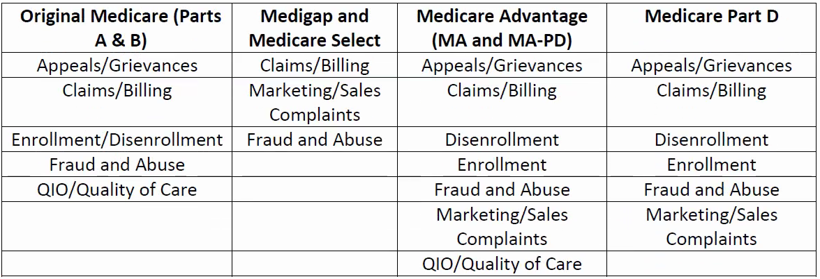
Beneficiary Contacts: SMP-Qualifying Topics
SMP-qualifying topics for beneficiary contacts are listed below.
For definitions and instructions, see Appendix C of the Beneficiary Contacts Job Aid.
Notes:
Stacey

Slide 16
Send to SMP Updates (Only impacts co-trained SMP/SHIP programs using the “Send to SMP” functionality in STARS)
Group Outreach and Education Form:
If “Send to SMP” is selected and “Enrollment Event” is selected, the record will not be sent to SMP and will not be saved to STARS. The following validation error will appear: “Send to SMP Error. An error has occurred while attempting to send your message to SIRS. Enrollment Event cannot be selected as the Type of Event.”
All Forms:
If “Send to SMP” is set to “Yes” and no SIRS eFile ID was entered, the following validation error will appear: “Send to SMP Error. Please enter a SIRS eFile ID in order to send this record to SIRS.”
Notes:
Stacey

Slide 17
ACL Guidance: SMP/SHIP/MIPPA
How do you report what you’re doing when there’s overlap?
ACL recently developed new Joint Reporting Guidance for SMP, SHIP, and MIPPA grantees
Provides an overview of what to report, when, and how
Replaces previous guidance issued by CMS and ACL in 2008
Team members trained in both SMP and SHIP may use STARS “Send to SMP” function to report counseling or outreach if the activity involves both programs
Notes:
Rebecca or Stacey

Slide 18
“Quick Calls” or “Simple Inquiries”
Includes:
Scheduling appointments
Unsuccessful attempts to reach a beneficiary
Contacts where the sole purpose is referral to another agency
Contacts that are unrelated to the mission of the grant program
DO NOT REPORT
These contacts do not count and should not be entered
Notes:
Rebecca or Stacey

Slide 19
Basic Counseling
Any contacts involving the relay of general Medicare or program information
SMP | SHIP
Complete SIRS Individual Interaction Form | Complete STARS Beneficiary Contact Form
Use the STARS “Send to SMP” radio button to report the contact in both systems if counseling includes discussing or gathering info about potential health care fraud, errors, or abuse. Record all time (in minutes) spent counseling. Time spent cannot be split.
Notes:
Rebecca or Stacey

Slide 20
Complex Counseling on Medicare
Involving in-depth assistance or casework
SMP | SHIP
Submit a Complex Interaction in SIRS for any complex counseling sessions (i.e. complaints, referrals, or other in-depth work on behalf of a beneficiary regarding potential fraud, errors, and/or abuse). | Complete STARS Beneficiary Contact Form
You may start the contact in STARS using the “Send to SMP” function but you must log into SIRS to make updates, upload documentation, refer to the OIG Hotline, and complete the Complex Interaction.
Notes:
Rebecca or Stacey

Slide 21
Group Outreach & Education Activity
SMP | SHIP
Complete SIRS Group Outreach and Education Form | Complete STARS Group Outreach and Education Form
You may use the STARS “Send to SMP” function to also report in SIRS when this activity involves educating on SMP services and preventing, detecting, and reporting potential health care fraud, errors, or abuse. Record all activity time (in minutes). Time spent cannot be split.
Notes:
Rebecca or Stacey

Slide 22
Media Outreach & Education Activity
SMP | SHIP
Complete SIRS Media Outreach and Education Form | Complete STARS Media Outreach and Education Form
You may use STARS “Send to SMP” function to send to SIRS when the media activity involves educating on SMP services and preventing, detecting, and reporting potential health care fraud, errors, or abuse. Record all time (in minutes). Time spent cannot be split between programs.
Notes:
Rebecca or Stacey

Slide 23
Other Activity Time
All other activity involved with managing and implementing the program that isn’t captured on other forms.
Includes time spent completing administrative tasks, managing your program, supervising team members, training, etc.
SMP | SHIP
Complete the SIRS Team Member Activity Form to report time spent on all other SMP activities. | Complete the STARS Team Member Activity Form for each team member to reflect the full amount of time spent on SHIP activities.
There is isn’t a “Send to SMP” feature for the Activity Form. You must enter all other program activity time directly into SIRS or STARS, as applicable.
Notes:
Rebecca or Stacey

Slide 24
STARS to SIRS Scenarios
Scenario 1: SHIP/SMP counseling session with suspected fraud or abuse (SMP complex interaction)
Scenario 2: SHIP/SMP presentation with two people helping
Scenario 3: Editing a counseling session in STARS and SIRS – data entry error
Notes:
Ginny

Slide 25
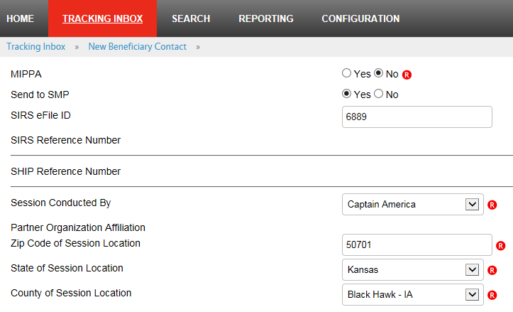
STARS to SIRS Scenario 1: SHIP/SMP counseling session with suspected fraud or abuse (SMP complex interaction)
1) Enter the session in STARS, using the “Send to SMP” functionality.
“Send to SMP” = “Yes”
“SIRS eFile ID” and “Session Conducted By” field indicate the team member who conducted the counseling session.
Notes:
Ginny

Slide 26
STARS to SIRS Scenario 1: SHIP/SMP counseling session with suspected fraud or abuse (SMP complex interaction)
1) Enter in STARS (continued)…
One or more qualifying topics must be selected.
Tip: See slide 15 for qualifying topics.
2) The information you entered will go to SIRS, but you’re not done…
Notes:
Ginny

Slide 27
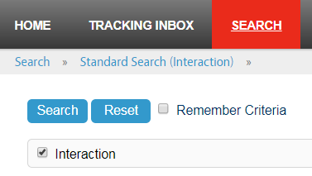
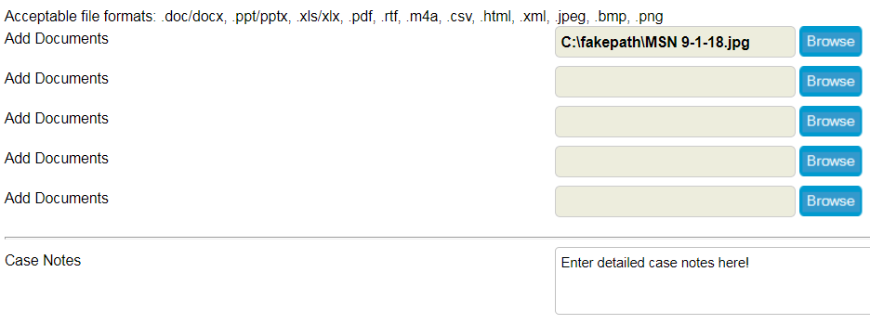
STARS to SIRS Scenario 1: SHIP/SMP counseling session with suspected fraud or abuse (SMP complex interaction)
3) Finish entering the case in SIRS (or notify whoever handles complex interactions at your SMP so they can enter it in SIRS.)
Find the case in SIRS using the SIRS reference number from STARS.
Upload any available documentation relevant to the case – documents uploaded in STARS do NOT transfer to SIRS.
Enter “Case Notes” to describe the complex interaction.
Notes:
Sara

Slide 28
STARS to SIRS Scenario 1: SHIP/SMP counseling session with suspected fraud or abuse (SMP complex interaction)
3) Finish entering the case in SIRS (continued)…
Change the “Status of Interaction” from “Closed – Handled by SHIP” (the default) to the appropriate SMP status. For example: “Open – Research in Progress” or “Open – awaiting response to referral.”
Update the “Date of Last Status Update” to today’s date.
See the SIRS Complex Interactions Job Aid, page 10 for additional instructions.
Notes:
Sara

Slide 29
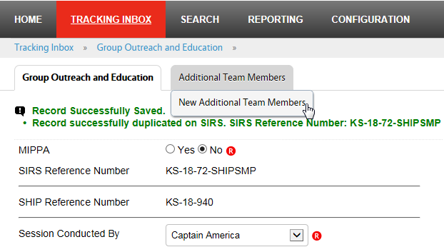
STARS to SIRS Scenario 2: SHIP/SMP presentation with two team members
1) Enter the presentation in STARS, using the “Send to SMP” functionality.
Enter the time spent by the first person in the GOE form.
Enter the time spent by the second person using the “Additional Team Members” tab on the GOE form.
Notes:
Ginny
The first team member is Captain America and the second team member is Mickey Mouse.

Slide 30
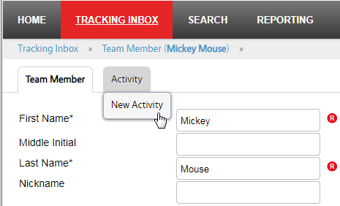
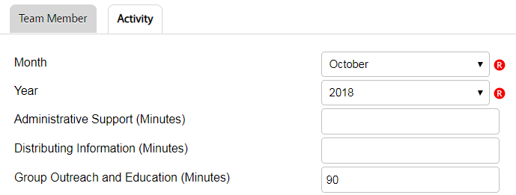
STARS to SIRS Scenario 2: SHIP/SMP presentation with two team members
2) The information you entered about the presentation will go to SIRS, and so will the time spent by the first person, but you’re not done…
3) Enter the time spent by the second person in SIRS using the Activity Form. See the SIRS System User Basics Job Aid for instructions.
Notes:
Sara

Slide 31
STARS to SIRS Scenario 3: Editing a counseling session in SIRS – data entry error
Mickey Mouse conducted a counseling session in which he talked to a beneficiary about Medicare plan options and also how to prevent Medicare fraud, errors, and abuse.
Minnie Mouse entered the counseling session in STARS on behalf of Mickey, and used the “Send to SMP” feature to send it to SIRS.
Notes:
Ginny
Notice the SIRS efile ID is autofilled with the logged in user’s SIRS eFile ID – Minnie Mouse. The Session Conducted By field also defaults to the logged in user. Here, Minnie has found Mickey Mouse’s name in the list of other team members, since he conducted the contact.

Slide 32
STARS to SIRS Scenario 3: Editing a counseling session in SIRS – data entry error
It turned out that when Minnie entered the session in STARS, she changed the “Session Conducted By” field to Mickey’s name, but she forgot to change the eFile ID to Mickey’s eFile ID.
Mickey’s SIRS eFile ID is 2061
Minnie’s SIRS eFile ID
Notes:
Ginny

Slide 33
STARS to SIRS Scenario 3: Editing a counseling session in SIRS – data entry error
Later, the SMP director noticed that Mickey’s counseling session appears in SIRS under Minnie’s name.
Now, for consistent and accurate data entry in SIRS, the session needs to be updated to show that it was conducted by Mickey, not by Minnie.
Notes:
Sara

Slide 34
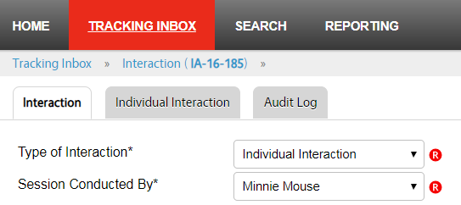
STARS to SIRS Scenario 3: Editing a counseling session in SIRS – data entry error
Before (incorrect):
Minnie’s name
After (correct):
Mickey’s name
Note: The SIRS eFile ID that was entered in the beneficiary contact form in STARS doesn’t appear on the individual interaction form in SIRS.
Notes:
Sara

Slide 35
STARS and SIRS Resources
ACL’s Joint Reporting Guidance
STARS to SIRS Tip Sheet
For SHIPs and SMPs who are co-training their team members and partnering on data entry
Quick Reference Guide on pages 5-10 provides a guide to entering, editing, and reviewing data in STARS and SIRS
STARS training and resources
See the first link under “Need Help with STARS?” on the STARS Landing Page: https://STARS.ACL.gov
SIRS training and resources
Search the SMP Resource Library for keyword “SIRS”: https://www.smpresource.org/Login.aspx
Notes:
Ginny

Slide 36
STARS Technical Assistance
For STARS technical assistance, contact the STARS help desk at Booz Allen Hamilton:
boozallenstarshelpdesk@bah.com or 703-377-4424
For questions about job aids and other STARS support resources, contact the SHIP TA Center
stars@shiptacenter.org or 877-839-2675
Notes:
Ginny

Slide 37
SIRS Technical Assistance
For help using SIRS, contact Sara Lauer at the SMP Resource Center
SIRS@smpresource.org or slauer@smpresource.org
For SIRS technical issues and password reset assistance, contact the SIRS help desk at Booz Allen Hamilton
BoozAllenSIRSHelpDesk@bah.com or (703) 377-4411
Notes:
Ginny

Slide 38
Questions?
The production of this webinar was supported by grant numbers 90SATC0001 and 90MPRC0001 from the Administration for Community Living (ACL).
Notes:
Heather facilitates Q&A

Slide 39
WebEx functionality
2
The view icon in the upper right corner changes your view in WebEx.
Tip: Select the middle option so you can see who’s speaking!
The toolbar on the left side of the screen allows you to zoom in and out to show a closer or farther out view of the PowerPoint presentation.
The menu at the bottom allows you to mute your line, open the participants and chat panels, and leave the event.
The panels on the right show participant information, chat, and polling (when in use). Use the arrow and x to open and close the panels.
Tip: To raise your hand, open the participant panel and click the hand icon in the lower right corner.
1
4
3
Notes:
Heather
I’d like to provide a quick tour of WebEx since this version is still fairly new.

