Slide 1
STARS Training:
Beneficiary Contact Form
-Ginny Paulson, SHIP TA Center
November 27, 2018
Notes:
Sue.

Slide 2


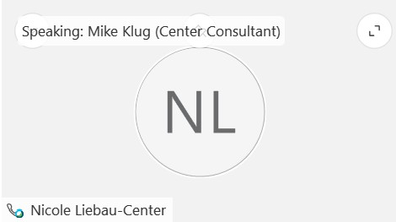
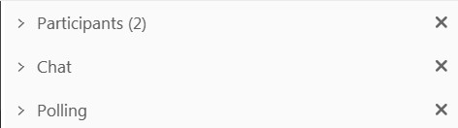


WebEx functionality
2
The view icon in the upper right corner changes your view in WebEx.
  Tip: Select the middle option so you can see who’s speaking!
The toolbar on the left side of the screen allows you to zoom in and out to show a closer or farther out view of the PowerPoint presentation.
The menu at the bottom allows you to mute your line, open the participants and chat panels, and leave the event.
The panels on the right show participant information, chat, and polling (when in use). Use the arrow and x to open and close the panels.
    Tip: To raise your hand, open the participant panel and click the hand icon in the lower right corner.
1
4
3
Notes:
Sue: overview of navigating WebEx

Slide 3
Agenda
Part One
About STARS and Timeline
Sharing Data Overview
Demonstration of Beneficiary Contact Form and Additional Beneficiary Sessions Form
Part Two
Additional Beneficiary Sessions Tips
Part D/MAPD Enrollment Data
Data Transfer from NPR
STARS Resources, Training, and Support
STARS Basics
Questions
Notes:
Ginny: Though you are certainly free to leave this webinar at any time, the content is divided into two Parts, as you can see here on the agenda. Some viewers have indicated they are really only interested in the demonstration. The demonstration is contained in Part One of today’s webinar. If you choose to stay for the webinar in its entirety, Part Two contains an explanation of the optional
Part D/MAPD enrollment measure, details about the data transfer from SHIP NPR, an overview of available STARS resources, and a Question and Answer period through chat.

Slide 4

About STARS
SHIP Tracking And Reporting System (STARS)
National, web-based data system
Developed and owned by ACL OHIC
  Contract with Booz Allen Hamilton
Sharing Data
  MIPPA
  SMP SIRS
  Duals Demonstration Grantees
Replaces SHIP NPR
  NPR goes away 11/30/18
  Historical data will be transferred into STARS
Notes:
SIRS = SMP Information and Reporting System

Slide 5
STARS
The following slides were created by
The Administration for Community Living (ACL)

Slide 6
Sharing Data Overview
SMP, MIPPA, Duals Demonstration
Notes:
Each of the three main forms (Beneficiary Contact, Group Outreach, and Media) have the option to record data with MIPPA, SMP, and/or CMS Duals Demonstration Grantees. If you are trained to conduct work in these programs, be sure to check the appropriate boxes to accurately report.

Slide 7
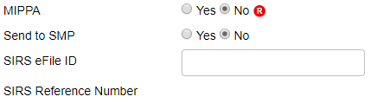

BCF MIPPA Reporting
MIPPA is a required field
Select “Yes” radio button when outreach includes MIPPA topics
      MIPPA BCF Topics Discussed include Extra Help/LIS, Medicaid, or Medicare Savings Program
Notes:
MIPPA is a required field
– might recall typing in MIPPA 1, 2, or 3 in SHIP NPR
Produced inconsistent results
First question on form ☺
Select “Yes” radio button when outreach includes MIPPA topics

Slide 8


CMS Duals Demo Grants
Current grantees include CA, IL, MA, MI, NY, OH, RI, and SC
Select new field “Duals Demonstration” in Additional Topic Details
Add “Notes” to capture additional detail related to the Topic Discussed for issue identification and trend tracking. Examples may include:
Topic Discussed | Sample ‘Note’
Claims/Billing | New MSN questions or improper billing
Medicare Buy-in | Part A Buy-in processing concerns with the local SSA office
Medicare Buy-in | Data communication concerns among the state, SSA, or CMS systems
Notes:
CMS Duals Demonstration Grantees currently include the states listed on the slide: California, Illinois, Massachusetts, Michigan, New York, Ohio, Rhode Island, and South Carolina. SHIP Team members in these states conducting duals grant work should indicate this work by selecting the “Duals Demonstration” in Topic Discussed section. There’s a new category called Additional Topic Details pictured on the slide showing the check box marked. In addition to selecting duals demonstration when appropriate, team members should indicate all other topics discussed. In addition, add details in the NOTES section to continue supporting specific needs of dual eligible and identifying systemic issues for analysis by ACL and/or CMS. A few examples of current trends appear in the table and may include improper billing related to QMB status being added to the MSN OR Medicare Buy-in concerns in data system communication errors among the state, SSA, or CMS.

Slide 9
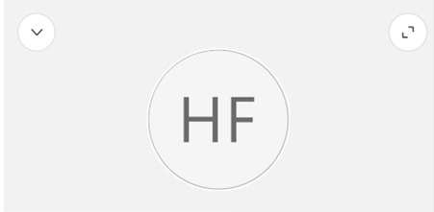

Demonstration Viewing Tips
During the demo, a gray box may appear on your screen with your initials.
You can:
Close the box by clicking the arrow in the upper left corner of the box.
Grab the box and move it out of the way.
Click the “Escape” key on your keyboard to show the panels on the right instead.
Notes:
This is an inconvenient aspect of the latest version of WebEx, but we aren’t able to remove it.

Slide 10
Demonstration
Notes:
STARS Landing Page; STARS Resources Page; Beneficiary Contact Form;

Slide 11
Beneficiary Contact Form
Notes:
What constitutes a beneficiary contact and when to complete a form has not changed from NPR. This training will focus only on the functions of STARS and the changes from NPR.
Reminder: A beneficiary contact includes all contacts for the purpose of relaying Medicare and SHIP-related information between a counselor or staff and a client. Contacts may occur with Medicare beneficiaries, family members, caregivers, or others working on behalf of a client.
A beneficiary contact does not include:
unsuccessful attempts to reach a client (e.g., leaving messages on an answering machine).
individuals reached at public events such as presentations or health fairs, or for questions asked during or after a presentation.
calls or other contact when the only purpose is to schedule an appointment with a SHIP counselor.
calls or other contact when the sole purpose is referral to another agency or program.

Slide 12
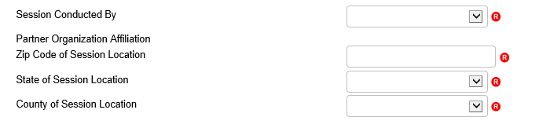
Session Conducted By
This section of the form collects information on the person that counseled or worked with the beneficiary
Use the drop down bars to select the correct options
  Partner Organization will auto-populate
  County will also auto-populate after you enter the Zip Code
  Remember: Session location is where you are when counseling

Slide 13
Beneficiary Information
Space to collect both the Beneficiary’s information and/or a Representative’s information as needed
None of these fields are required BUT please enter the name and phone number as often as possible
  ACL needs the name and phone number to conduct beneficiary satisfaction surveys

Slide 14
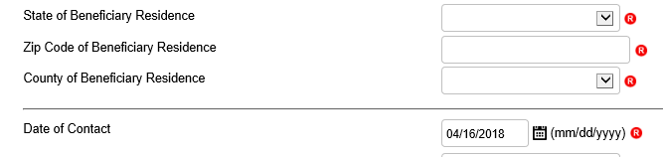
Beneficiary Residence Info
This information is required
Date of Contact
This information is required
Manually enter the date or use the Date Picker tool by clicking on the calendar icon
Notes:
Must use dropdown to select state
must enter zip code
Auto-populates county based on zip code, can choose another county if applies

Slide 15
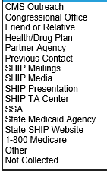
How Did Beneficiary Learn About SHIP?
Updated options include:
  Congressional Office
  Health/Drug Plan
  SHIP TA Center
  Social Security Administration (SSA)
  State Medicaid Agency
“1-800-Medicare” separate from “CMS Outreach” option so appear as separate selections independent of each other
Added “SHIP” as a qualifier in front of some of the selections to clarify that the selections are specific to SHIP activities/efforts. (i.e. “SHIP Mailings” and “SHIP Presentation”)
Notes:
INCREASINGLY, REALLY IMPORTANT
State or federal congressional office
Health/drug plan – your relationships, required by CMS in notices
SHIP TA – locator tracking
Based on your partnership work = SSA = based on your work at partnership, used to be included on “partner agency”
Medicaid =

Slide 16
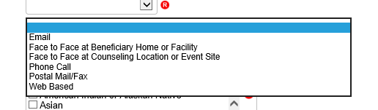
Method of Contact Changes
The options under Method of Contact have changed slightly from NPR to include Web-based contacts
  This option would be selected when using things such as website chat options to counsel a beneficiary
Notes:
Web based = working to define

Slide 17
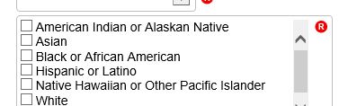
Beneficiary Demographics
Age Group - Options have not changed from NPR
Gender - Now includes “Other”
Race - Consolidated choices to mirror other ACL system fields:

Slide 18
Topics Discussed
Largest section of the Beneficiary Contact Form
Select as many options as are necessary to fully explain beneficiary assistance
Must select at least one topic discussed
The following slides highlight changes from NPR but do not capture all of the Topics Discussed in STARS

Slide 19
New Topics Discussed: Disenrollment
New option under Medicare Advantage and Medicare Part D
  To be used plan disenrollment at any time (not limited to the Open Enrollment Period)
  Allows tracking of enrollments and disenrollments separately, lesson from Part D Enrollment Pilot

Slide 20
New Topics Discussed: Part D LIS
Two new options found under Part D Low Income Subsidy (LIS/Extra Help)
  Application Submission: Selected if assist with submission of an LIS application, either paper or electronically via SSA’s website.
  LI NET/BAE: Selected if assist accessing the limited Income Newly Eligible Transition Program (LI NET) benefit for those with an LIS award but no Part D coverage. Examples include:
    providing LI NET education to pharmacy
    submitting required documents for the Best Available Evidence (BAE) process if LIS award is not reflected in CMS/SSA systems

Slide 21
New Topics Discussed: Medicaid
Expanded options under the Medicaid header to include:
  Application Submission
  Medicare Buy-In Coordination
  Medicaid Managed Care
  Recertification

Slide 22
New Topics Discussed: Other Insurance
Several additional options have been added under Other Insurance:
  Active Employer Health Benefits
  Indian Health Services
  Retiree Employer Health Benefits
  Tricare For Life Health Benefits
  Tricare Health Benefits
  VA/Veterans Health Benefits

Slide 23

New Topics Discussed: Additional Topics
A whole new category of topics has been added under the header Additional Topic Details which includes:
  Ambulance
  Dental/Vision/Hearing
  DMEPOS
  Duals Demonstration
  Home Health Care
  Hospice
  Hospital
  New Medicare Card
  Preventive Benefits
  Skilled Nursing Facility
Note to CMS Duals Demonstration Grantees:
Contact forms must include selection of “Duals Demonstration” on this area of the form (pictured below).
Notes:
Can select these AND Original Medicare in the Parts A & B box.
These topics should allow more specific detail tracking of common concerns of beneficiaries.

Slide 24
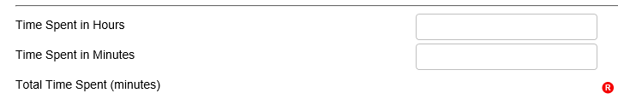
Time Spent
Enter all of the time you spent helping the beneficiary during this contact. Includes:
  All time meeting with beneficiary or representative
  Any time spent researching, preparing materials, completing paperwork/form, and traveling to meet with the beneficiary.
Enter time in whole hours and minutes
  The system will auto-calculate the total time in minutes (required)
Notes:
1.5 hours would be entered as either:
1 hour and 30 minutes or
90 minutes

Slide 25
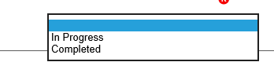
Status
STARS has only two status options:
  In progress
  Completed

Slide 26
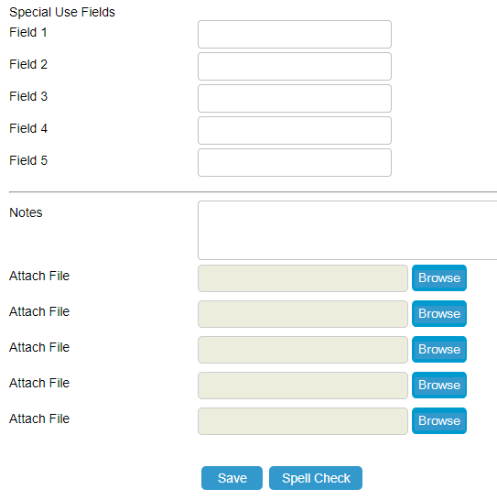
SUFs, Notes, and Attach File
Special Use Fields
  No longer used for MIPPA!!!
  4th and 5th for NPR transfer data
Notes
  Track ‘other’ by typing consistent (e.g. Non-STARS Event Partners, New Medicare Card, etc.)
Attach file
  File types: .doc/docx .ppt/pptx .xls/xlx .pdf .rtf
  Size limit 500MB
Notes:
Special Use Fields
No longer use for MIPPA!!! = use MIPPA radial button instead at top of form
4th and 5th for NPR transfer data = only being used for transferred data, available otherwise, just FYI
Notes: Track ‘other’ by typing consistent (e.g. Non-STARS Event Partners, New Medicare Card, etc.)
Attach Any file type

Slide 27
Part Two
Tips for Beneficiary Additional Sessions; Part D/MAPD Enrollment Data; Data Transfer from NPR; STARS Resources, Training, and Support; Questions

Slide 28
SHIP Beneficiary Additional Sessions
Illustrating Complexity

Slide 29
Additional Contacts on Same Issue
When to use the Beneficiary Additional Sessions:
  Group contacts involving the same complex issue(s)
  Document multiple contacts, time spent, and topics discussed to a resolution
When NOT to use the Beneficiary Additional Sessions:
  Same SHIP counselor has multiple contacts on the same day with the same beneficiary or representative (edit and resave form instead)
  Two or more SHIP counselors help the same beneficiary or representative on the same day (enter multiple forms)

Slide 30
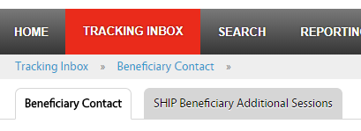
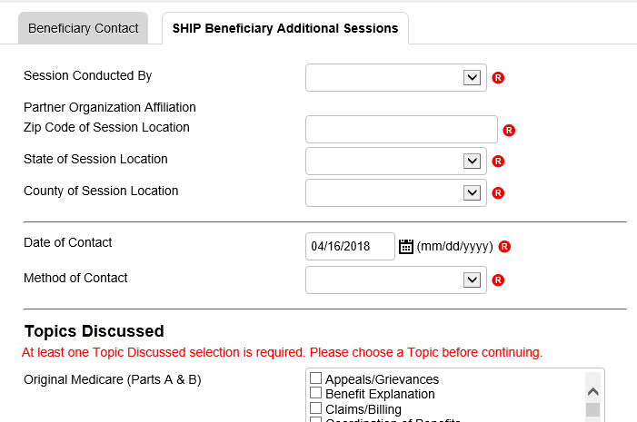
Entering Additional Sessions
Can add as many additional contact forms as needed
Each additional contact counts the same way as a stand-alone contact on SHIP Performance Measures
Note: API feature does not currently support this feature. ACL is working with BAH on a possible enhancement to add this to API.

Slide 31
What if fields I need aren’t on the Beneficiary Additional Sessions (BAS) tab?
  Beneficiary demographic information does not appear on the BAS, but the demographics entered on the Beneficiary Contact Form (BCF) are considered to be relevant for all associated BASs. Edit the demographic information on the BCF, when applicable.
  Send to SMP and MIPPA fields do not currently appear on the BAS. Enter a new BCF if the case evolves into an SMP or MIPPA issue.

Slide 32
What if fields I need aren’t on the Beneficiary Additional Sessions (BAS) tab? (Continued)
  Part D cost SUF fields (Original PDP/MA-PDP and New PDP/MA-PDP) do not appear on the ABS. They may be added in a 2019 enhancement. Meanwhile, enter a new BCF if the case evolves into helping a client with enrollment.
  Status does not appear on the BAS. Until there’s an enhancement, edit the status on the associated BCF when a case status changes from “In Progress” to “Completed.”

Slide 33
SYSTEM SECURITY
Notes:
Let’s spend a few minutes to talk about STARS system security before we move to the next topic about Part D enrollment cost data. We’ve received several inquiries about STARS and entering either Personally Identifiable Information or PII and Protected Health Information or PHI.

Slide 34
STARS Security
Federal Information Security Management Act (FISMA) moderate
  Data encrypted during API transfer
  Data encrypted in STARS
  Password requirements
    Valid 90 days (currently disabled, will implement Oct. 2018)
Notes:
The Federal Information Security Management Act of 2002 addresses the importance of information security to the economic and national security interests of the US. The act requires each federal agency to develop, document, and implement an agency-wide program to provide security for the information and information systems, like STARS, that support the operations and assets of the agency. This includes those provided or managed by another agency, contractor, or other source, like Booz Allen Hamilton does on behalf of ACL.
There are several FISMA categories. STARS is the FISMA category known as moderate.

Slide 35
PII and PHI
Personally Identifiable Information (PII) | Protected Health Information (PHI)
Information which can be used to distinguish or trace an individual’s identity, such as their name, social security number, biometric records, etc. alone or when combined with other personal or identifying information which is linked or linkable to a specific individual, such as a data and place of birth, mother’s maiden name, etc.”¹ | Individually identifiable health information that is explicitly linked to a particular individual, and health information which can allow individual identification.² PHI includes many common identifiers (e.g., name, address, birth date, Social Security Number) when they can be associated with the health information listed above.
OMB M-07-16 Memo Safeguarding Against and Responding to the Breach of Personally Identifiable Information
Health Insurance Portability and Accountability Act of 1996 website
Notes:
In conducting SHIP work, we collect both Personally Identifiable Information and Protected Health Information. The biggest differences between the two items are:
PII is ANY potentially identifying either on it’s own or when combined with other information = most of information in STARS. STARS is built to house this information securely
PHI is HEALTH information and specifically identifies a person. This sometimes entered in notes/comment field. STARS is built to house this information securely, exercise caution and only enter when necessary or requested.

Slide 36
Tips for Handling Sensitive Data
Use private spaces to ensure sensitive data is safeguarded
Store all hard copies securely in locked filing cabinets or offices with a maintained filing system
Password protect electronic formatted documents and equipment (phones, computers, USB drives)
Do not leave files of documents with PII on desks, printers, personal computers, phones or other devices
Send and forward only encrypted emails with PII
Clear web browser history
Disable auto-fill on web browser

Slide 37
Part D/MAPD Enrollment Data
Notes:
Reporting cost information about Part D and Medicare Advantage plans with Part D coverage enrollment assistance is a new opportunity in STARS. This is an optional reporting field. ACL encourages SHIP team members to collect and report these data, but does not require it be reported. I’ll use the term Part D in coming slides and when I say this I mean both stand alone Part D prescription drug plans, sometimes listed as P-D-P’s on the slides and in STARS. Likewise, when I say Part D for this purpose, I mean Medicare Advantage Plans with Part D coverage which you’ll see listed as M-A-P-D’s on the slides and in STARS.

Slide 38
Overview
SHIP Evaluation results showed that SHIPs strongly desire a way to measure savings to Medicare beneficiaries
ACL Pilot:
  Over the last year ACL has conducted a pilot project with a number of SHIPs to test collection of enrollment data.
  Counselors in the pilot reported the before and after costs whenever they assisted with a Part D or MAPD enrollment.
  Data used comes directly from the Medicare Plan Finder
  Data from pilot was encouraging enough for ACL to decide to roll-out these data elements to everyone now
Goal is to provide more detailed information on the work that SHIPs do and the service we provide to beneficiaries
Notes:
Why is a ACL doing this?
When the SHIP Program moved to ACL in 2014, a program evaluation was conducted. Many SHIPs asked for a more consistent way to collect and report savings to Medicare beneficiaries based the important work you do. So, ACL conducted a pilot over the past year to look at Part D savings. Thank you to those that participated by reporting the cost of the beneficiary’s plan before and after SHIP counseling located on the Medicare Plan Finder. The pilot results were encouraging and with the STARS system we have the opportunity to collect and report dollars nationally. SHIPs help beneficiaries in many important ways that are weedy, technical and hard to describe, the goal of collecting Part D cost change data is to provide one more benefit of the program and the work you do!

Slide 39
Components of New Data
New Data allows analysis of three components that will help measure the impact of SHIP programs’ ability to provide cost changes savings for beneficiaries:
  Number of beneficiaries who received PDP/MA-PD enrollment assistance;
  Average cost change savings per beneficiary who received PDP/MA-PD enrollment assistance;
  Total cost change savings for state.
Not a Performance Measure
  Report data when assist with application completion (not with comparison only)
  Part D comparisons are counted in Performance Measure #5
Notes:
In the pilot we learned to use the term ‘cost changes’ vs. savings. Cost changes better reflects when a beneficiary saves as well as instances when beneficiaries pay more for to get a better coverage of a specific drugs or other personal choices.
This data is NOT a performance measure. With Part D data, we’re asking that you only report cost changes when completing applications on behalf of beneficiaries. There are many reasons beneficiaries enroll on their own and come to you only to compare plans. Plan comparisons are important and critical work. Comparison help will not be reflected in this Part D data. Comparison work is included as a factor in the SHIP Performance Measure #5.

Slide 40
Part D/MAPD Enrollment Data Steps
Collect current and future (old and new) plan estimated cost information from Medicare Plan Finder (MPF).
Assist beneficiary with enrollment via MPF or via phone or paper application and keep application confirmation. Select PDP/MA-PD Enrollment as a Topic Discussed on the BCF.
Enter plan cost amounts in STARS SUFs on the initial Beneficiary Contact Form (BCF)*
Attach cost and enrollment verification to the initial BCF*
  Proprietary system users will need to keep these documents somewhere locally where they could be accessed if audited.
*SUFs and File Attachment not available on Additional Sessions Tab
Notes:
If you’re reporting cost change data, these are the steps to follow.
Talk through steps
IMPORTANT NOTE: Special Use Fields and File Upload/Attachments are not available in the Additional Sessions Tab. When reporting cost change data, edit the initial form and resave to add details.

Slide 41
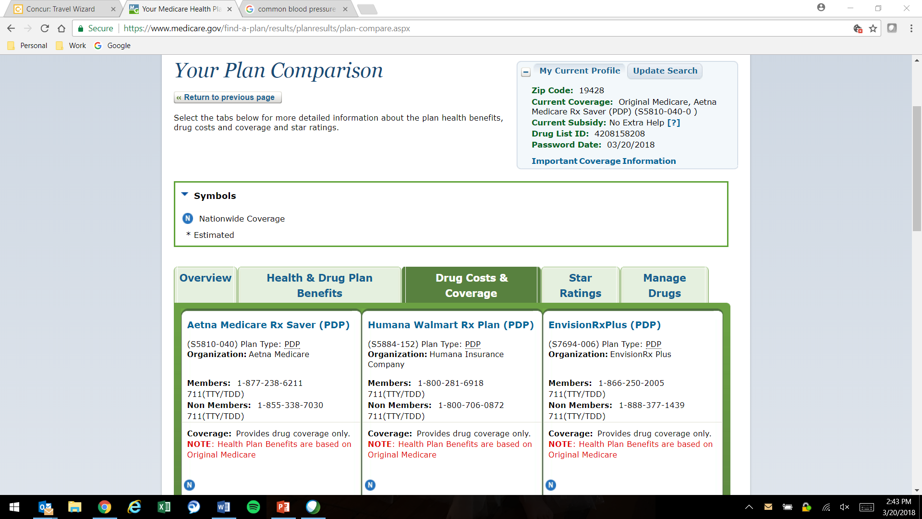
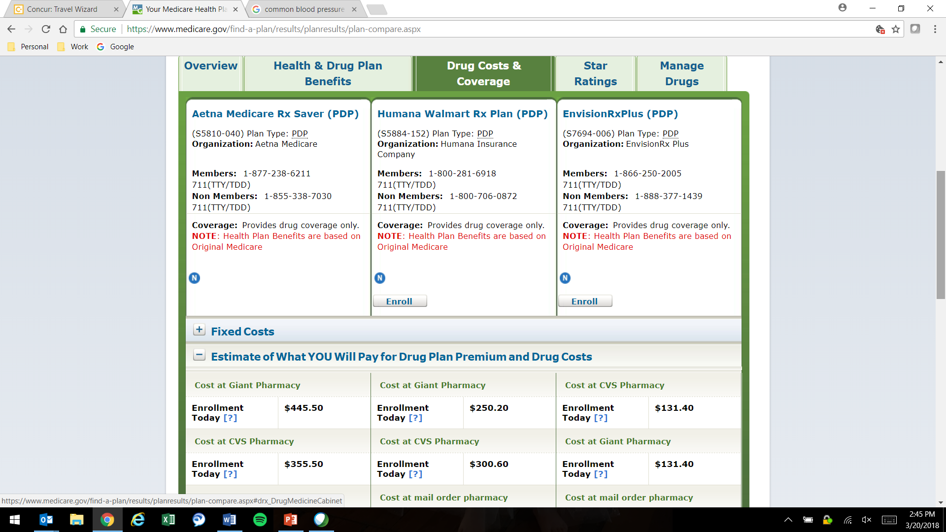
Step 1: Part D/MAPD Cost Comparison Data
Original Part D/MAPD (current): Aetna Medicare Rx (PDP)
Cost: $445.50
New Part D/MAPD (future): EnvisionRxPlus(PDP)
Cost: $131.40
Notes:
This slide is a quick screen shot is probably looks familiar to you. It’s from the Medicare Plan Finder. This view shows the location of plan the beneficiary is currently enrolled in in the top right in a red circle, the Aetna MedicareRx plan. This plan has a cost of $445.50 using the Giant Pharmacy.
This screenshot also shows the cost associated with the EnvisionRx Plus plan the beneficiary wants to join with a cost of $131.40 at Giant.
NOTE: there is no PII or PHI is included on this screen shot. And, you may prefer a different comparison view. There are multiple ways to display cost information on the Medicare Plan Finder and you can use any you chose so long as the original and new cost are clearly in view.

Slide 42
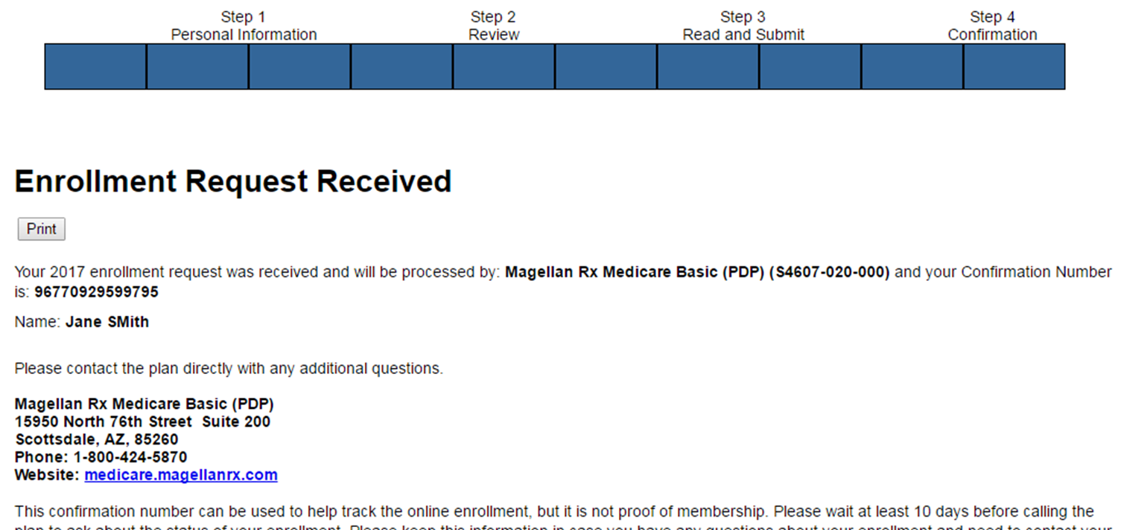
Step 2: Application Confirmation
If enrolling by another method (plan’s website, phone, etc.) an enrollment confirmation information must be saved.
If using MPF, upload the MFP application confirmation
New Part D/MAPD (future)
Notes:
If using the plan’s website, calling the plan, or some other alternative for Part D enrollment, the SHIP team member must have an application confirmation and upload it into STARS.
The Application confirmation from the Medicare Plan Finder does include PHI. Remember, STARS meets the FISMA moderate category for the federal government security requirements. Alternatives to avoid uploading PHI:
Add a colored box over the bene name when saving the document
Print and mark over the name before scanning and uploading the document.
Some counselors asked whether they should save these documents for uploading on a public computer, say at a library. If so, be sure to see the STARS security slick sheet for tips to delete files. Or keep a password protected USB (thumb) drive handy and save them there for uploading.

Slide 43
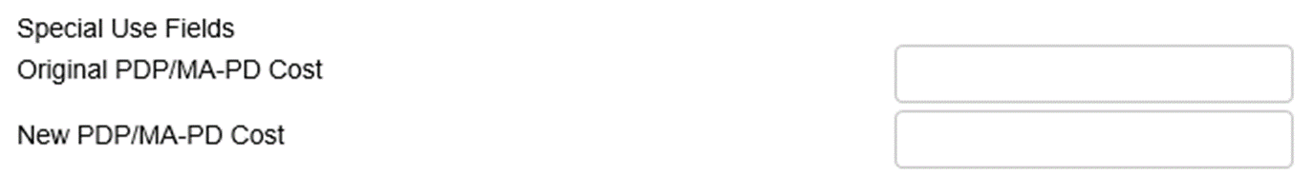

Step 3: Enter Cost Data in STARS SUFs
Original PDP/MA-PD Cost
Enter the Estimated Drug Cost* of the plan the beneficiary’s current plan listed on MPF
If beneficiary has no current Medicare PDP/MA-PD plan, then enter the drug costs displayed for Original Medicare on MPF
New PDP/MA-PD Cost
Enter the Estimated Drug Cost* of the future plan the SHIP team member assists the beneficiary current plan listed on the MPF
* Enrollment timing will dictate whether the ’Estimated Drug Cost’ appears as an ‘annual’ cost or ‘rest of year’ cost.
Original Part D/MAPD (current): Aetna Medicare Rx (PDP)
Cost: $445.50
445.50
131.40
New Part D/MAPD (future): EnvisionRxPlus(PDP)
Cost: $131.40
Notes:
When entering the cost data for the Part D plans the beneficiary’s current plan cost should be entered in the “Original PDP/MAPD Cost’ text box. If the beneficiary doesn’t have a plan or their plan is no longer available because it ended or they moved, use the cost associated with Original Medicare as if there were no drug coverage.
And, then enter the future plan cost entered in the “New PDP/MAPD Cost” box.
In previous webinars we advised that you must round to the nearest whole dollar. That advice has changed and you are not required to round and can simply enter the dollar amount. This box is a text box and will accept whatever is entered so be sure to Double check the entry since it’s easy to add to many zeros or a keyboard button to stick.

Slide 44

Step 4: Attach Cost Verification Sources
Attach the following verification near the bottom of the Beneficiary Contact Form:
  1. Application confirmation (Step 2 example)
  2. Cost change verification (Step 1 example)
Notes:
ACL anticipates a significant level of interest and examination by entities such as Government Accountability Office (GAO) and Office of Inspector General (OIG), and therefore, ACL must ensure that the data is able to withstand the scrutiny of an audit. ACL encourages SHIP Team members to report and upload cost change information as often as possible and understand the complex reason why it won’t always be possible.
ACL and your SHIP leaders will randomly review records with cost change data in the SUFs to confirm of the cost in the ‘original’ and ‘new’ plan supporting documentation is available. If the cost change verification documents are not present, the cost change information will be removed from the SUFs. The remainder of the beneficiary contact form will remain unchanged.

Slide 45
Data Transfer from NPR

Slide 46
Data Transfer and Timing
BAH will transfer the NPR data when all SHIPs are using STARS and no longer entering data into NPR
NPR data will be available as read-only until November 30th; NPR will no longer be available after November 30

Slide 47
Accessing NPR Data in STARS
NPR data will be moved to the state level in STARS
  Only State-level users will be able to see and search this data
Individual forms can be reassigned to STARS team members and sites by state level staff, BAH, or ACL if needed
Counselor field on NPR transferred data will be blank in STARS
  Counselor information will be saved in the 4th SUF in the transfer
  Agency name will be saved to the 5th SUF

Slide 48
STARS Access
Notes:
Before we get into the demon

Slide 49
New STARS User Access
1. Team Member Profile
*2. Credentials sent
(i.e. Username and Password)
3. STARS landing page link
Notes:
When the “Send Credentials” radio button on the STARS team member form is marked “yes,” the that team member will be emailed their “credentials” (username and password). This information will arrive from STARS in separate auto-generated emails to the email address that was entered on the team member form. The sending address will be DoNotReplyACLSystems@bah.com.

Slide 50
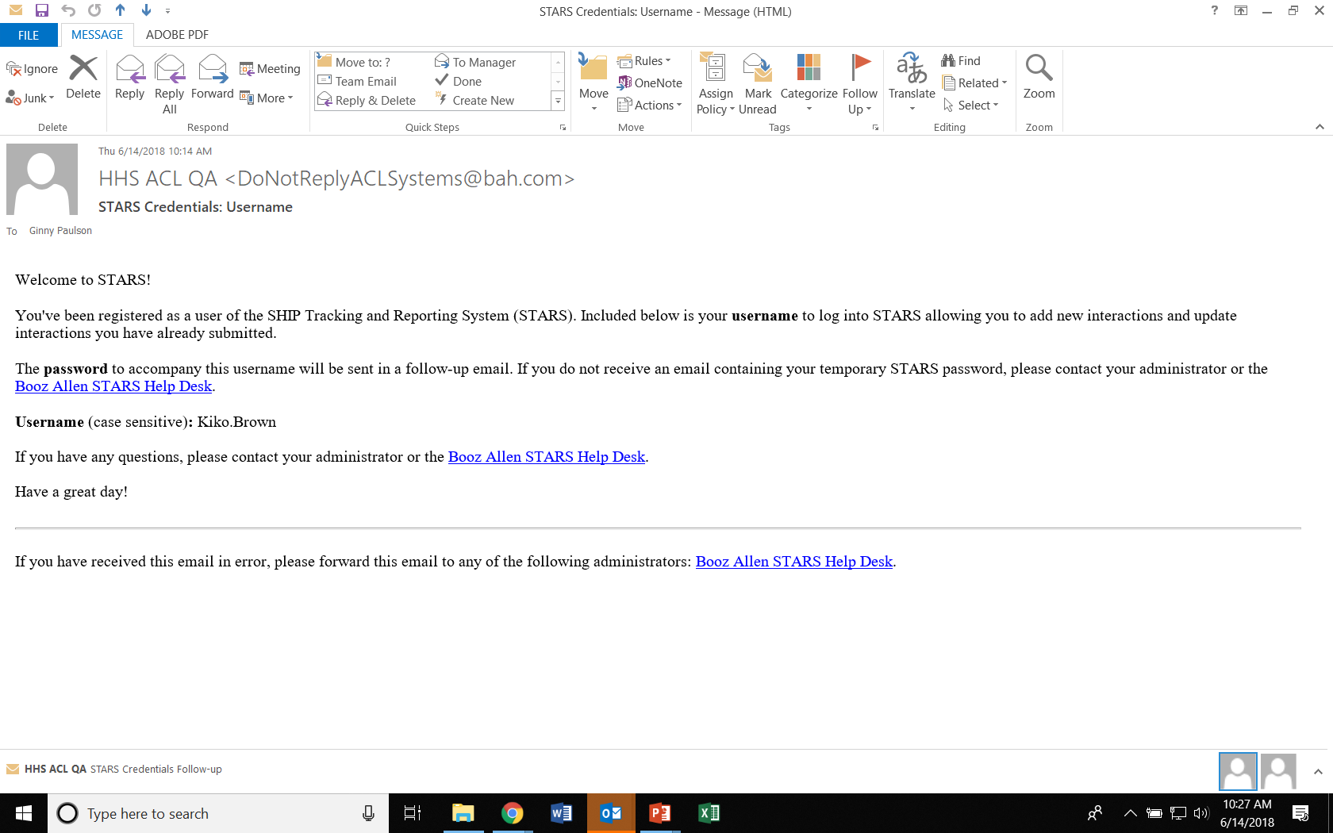
Credentials email

Slide 51
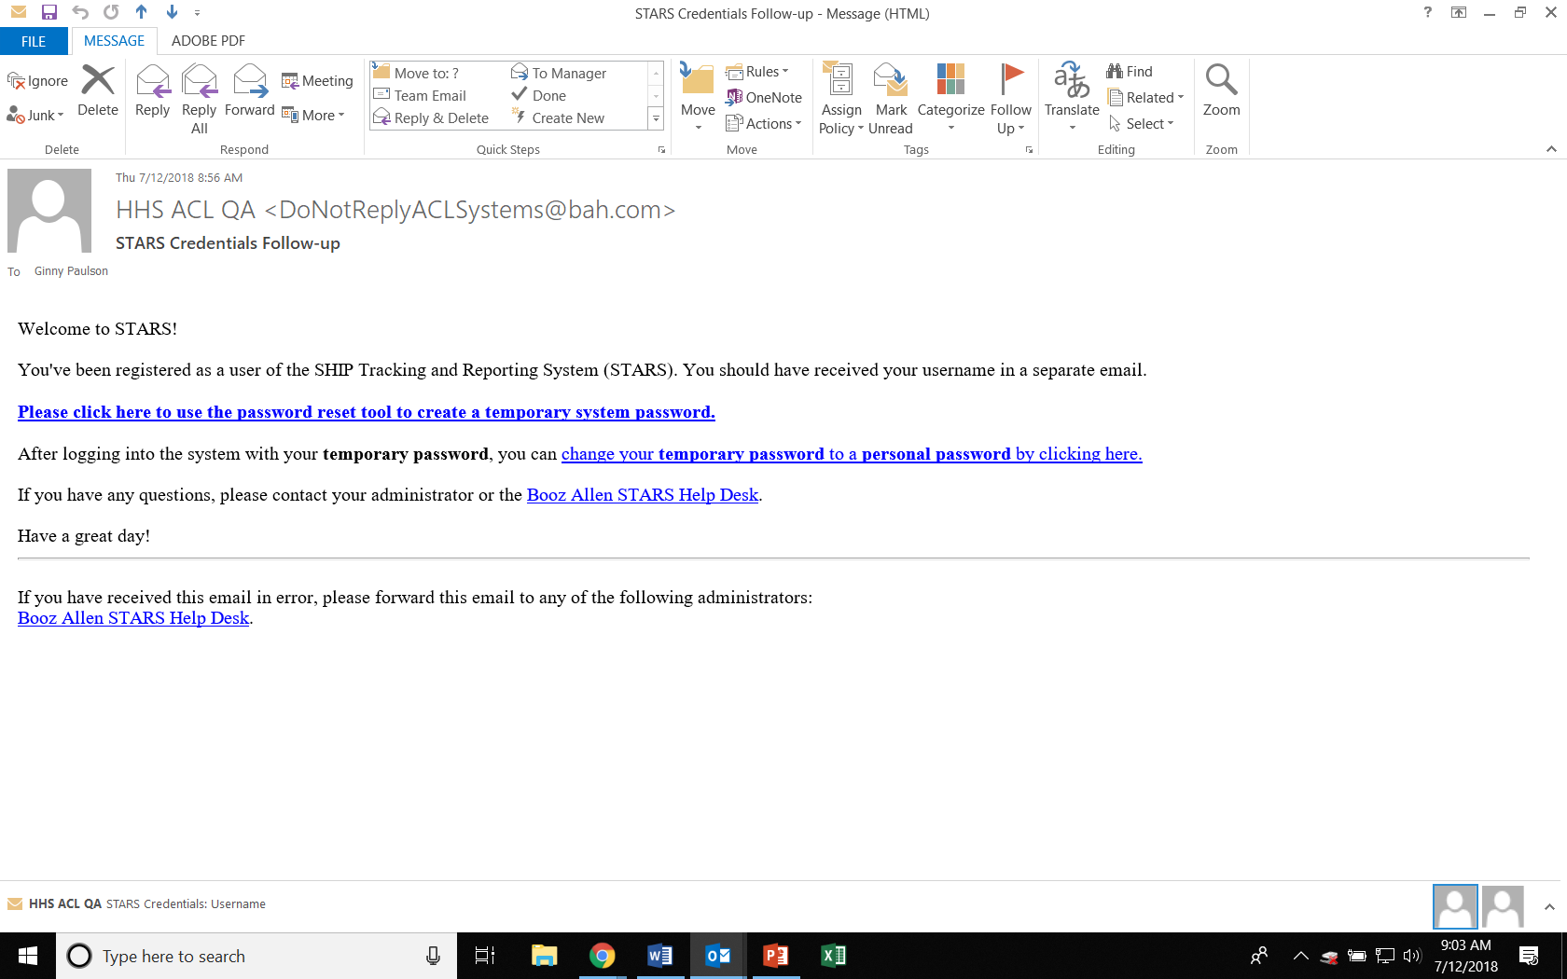
Password Email (possibility A)
Notes:
This is the email sent to users who are sent credentials at a later date than when their team member form was created. Responding to this email generates a password re-set, and the user will receive a second password email with a temporary password.

Slide 52
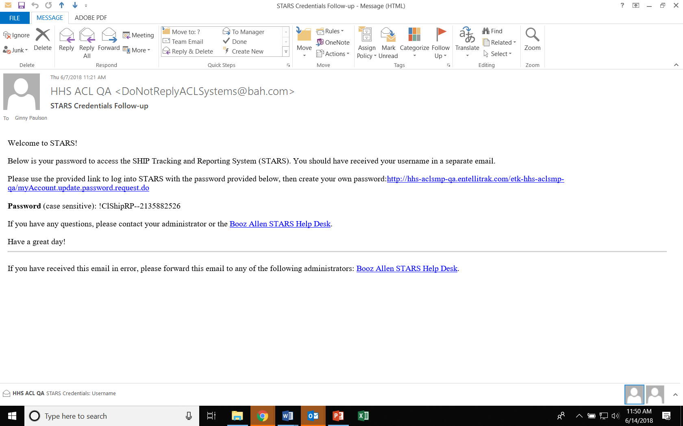
Password Email (possibility B)
Notes:
This is an example of an email containing the temporary password. When credentials are sent concurrent with team member creation, this is the email users receive. Notice that a temporary password is provided (which users should change after logging in to something private and also easier to remember).

Slide 53
STARS Resources, Training, and Support
Webinars
Manual
Job Aids
Notes:
The SHIP TA Center is responsible for hosting webinars, creating job aids, and housing STARS support materials online. ACL is updating the STARS manual based upon the former SHIP NPR manual. It will not be fully updated until later in 2018. Meanwhile, users should rely on the SHIP NPR manual and leaders at your SHIP for guidance about definitions, terms, and reportable activities. Users should rely on STARS job aids and STARS training webinars for data entry instructions.

Slide 54
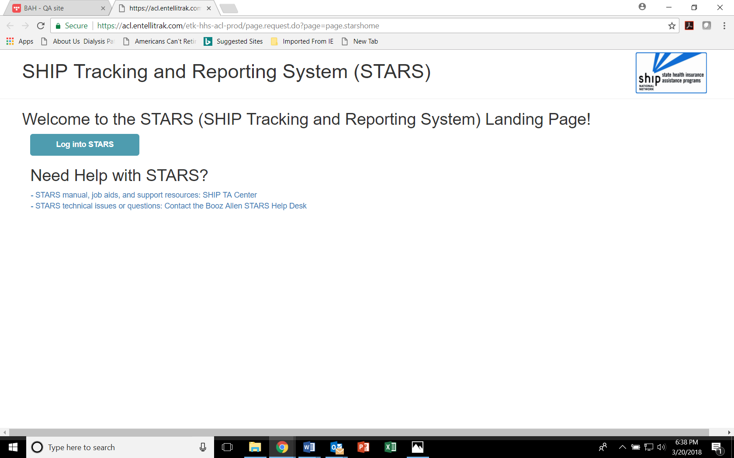
STARS Landing Page
https://stars.acl.gov
Contains link to SHIP TA Center STARS training materials, including webinar PowerPoints, recordings, and job aids
Contains link to Booz Allen STARS Help Desk
Notes:
Anyone with the link can visit the STARS landing page now. BUT, only users with credentials can successfully log in. Anyone who visits this page WILL be able to follow the link to the STARS resources, however. It is up to leaders in each SHIP program to distribute the STARS landing page link as appropriate.

Slide 55

STARS Job Aids
STARS User Basics
  One for STARS Submitter role
  One for all other roles
Beneficiary Contact Form
Group Outreach and Education Form
Media Outreach and Education Form
Team Members
STARS Launch
FAQs
Searches
Reports (2019)
Notes:
Topics in green are available now. They have been updated since their original release dates. The Reports job aid will be provided after the reports have been released into STARS.

Slide 56

Other Written Resources
PowerPoints for every STARS topic
User Roles at-a-glance (one page overview)
Beneficiary Contacts definitions
Group Outreach and Education definitions
Media Outreach and Education definitions
Printable versions of the STARS forms
STARS Security handout (i.e. slick sheet)
STARS Manual
Notes:
Topics in green are available now. By the way, we post the PowerPoint files from webinars – not PDFs – so that you can edit and use locally if desired. The STARS Manual will be available later this year. It will expand upon the job aids with increased definitions and guidance. Essentially, it will collect all STARS instructions and guidance in one document.

Slide 57
STARS Webinar Series
Group and Media Outreach Forms
November 29)
About this series
Intended for all users invited by a SHIP leader
STARS Searches and Reports
(TBD)
Entering Team Members
(December 20)
Notes:
This STARS launch webinar series began in March 2018 and will continue through October 2018. We have concluded our series on entering team members, and we are launching a new topic on Searches.

Slide 58
Webinars and Other STARS Resources
Future Webinar Announcements
  Provided to the SHIP director listserv
  Emailed only to director/administrator users of the Center’s website.
  Directors and Administrators must redistribute invitations within their program.
Webinar PPTs, webinar recordings, job aids, forms, and other resources
  Posted under “Need Help” on the STARS landing page

Slide 59
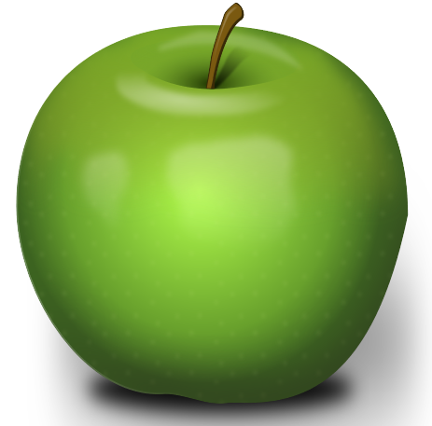
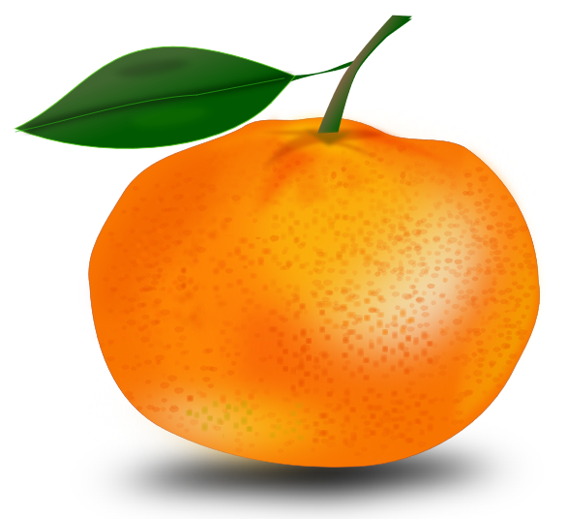
What’s the difference?
* STARS
* www.shiptacenter.org
Operated by ACL and Booz Allen Hamilton
SHIP data reporting system
Contains links to all STARS training materials for all Users
Supported by ACL, Booz Allen Hamilton, and the SHIP TA Center
Operated by the SHIP TA Center
Houses resources to help SHIPs train and manage their programs and educate the public
Supported by the SHIP TA Center
* Both require logging in, but they are separate systems and require separate accounts (think apples and oranges)
Notes:
Ginny: Here is a slide we have started using in our webinars to help people understand our Center’s website vs. the STARS website and our role with each.

Slide 60
Individualized Technical Assistance
To learn about future STARS training, contact your SHIP program’s leaders.
For STARS technical assistance, such as with usernames and passwords or your organizational hierarchy, contact the STARS help desk at Booz Allen Hamilton:
  boozallenstarshelpdesk@bah.com or 703-377-4424
For questions about job aids and other STARS support resources, contact the SHIP TA Center,
  stars@shiptacenter.org or 877-839-2675.

Slide 61
Have Questions?
Please send them through chat. See the blue chat bubble at the bottom of your screen.
Notes:
Due to the size of today’s audience, we are taking questions through chat.

Slide 62

Thank you for participating!
Today’s webinar materials are available for download within WebEx.
They are also posted at https://stars.acl.gov
The production of this webinar was supported by grant number 90SATC0001 from the Administration for Community Living (ACL).

